Slide 1

CS 586 MDABankAccount Project Report
Jiaqi Yan
jyan31@hawk.iit.edu
A20321362
Spring 2016
“A bank is a place where they lend you an umbrella in fair weather and ask for it back when it begins to rain.” --- Robert Frost

Slide 2
Table of Contents
1. MDA-EFSM Model for the Account Components
2. Class Diagrams of All Components
3. State Pattern
4. Strategy Pattern
5. Abstract Factory Pattern
6. Details for Other Classes
7. Dynamics for Two Scenarios
8. Source Code and Patterns
9. Source Code

Slide 3
1. MDA-EFSM Model for the Account Components

Slide 4
1. MDA-EFSM Model for the Account Components

Slide 5
1. MDA-EFSM Model for the Account Components
As shown in the previous EFSM figure for model driven architecture, I choose to use the sample solution provided at Blackboard.
The list of meta events in the MDA-EFSM:
Open()
Login()
LoginFail()
Login()
IncorrectPin(int max)
CorrectPin()
AboveMin()
BelowMin()
Deposit()
Balance()
WithdrawFail()
Withdraw()
WithdrawBelowMin()
LockFail()
Lock()
UnlockFail()
Unlock()
Suspend()
Activate()
Close()
The list of meta actions in the MDA-EFSM:
StoreData(): store PIN, ID and balance data into DataStore
IncorrectIdMsg(): show “incorrect ID number” msg to user
IncorrectPinMsg(): show “incorrect PIN number” msg to user
TooManyAttemptMsg(): show “too many attempts” msg to user
DisplayMenu(): display menu on the console
DoDeposit(): deposit money into user’s account
DoWithdrawn(): withdraw money from user’s account
DisplayBalance(): display current account’s balance
PromptPin(): prompt for PIN number
NoFundMsg(): show “no sufficient money” msg to user
Penalty(): deduct penalty from user balance

Slide 6
1. MDA-EFSM Model for the Account Components
Pseudo-code of InputProcessors for Account1
void open(string p, string y, float a) {
data->temp_pin = p;
data->temp_id = y;
data->temp_b = a;
mda->Open()
}
void pin(string x) {
if (x == data->pin) {
mda->CorrectPin();
if (data->b > min_balance) {
mda->AboveMin();
} else {
mda->BelowMin();
}
} else {
mda->IncorrectPin(max_attempts);
}
}
void deposit(float d) {
data->temp_d = d;
mda->Deposit();
if (data->b > min_balance) {
mda->AboveMin();
} else {
mda->BelowMin();
}
}
void withdraw(float w) {
data->temp_w = w;
if (data->b <= min_balance) {
mda->WithdrawFail()
} else {
mda->Withdraw();
}
if (data->b > min_balance) {
mda->AboveMin();
} else {
mda->BelowMin();
}
}
void balance() {
mda->Balance();
}
void logout() {
mda->Logout();
}
void lock(string x) {
if (x == data->pin) {
mda->Lock();
} else {
mda->LockFail();
}
}
void login(string y) {
if (y == data->id) {
mda->Login();
} else {
mda->LoginFail();
}
}
void unlock(string x) {
if (x == data->pin) {
mda->Unlock();
if (data->b > min_balance) {
mda->AboveMin();
} else {
mda->BelowMin();
}
} else {
mda->UnlockFail();
}
}
max_attempts = 3;
min_balance = 500;

Slide 7
1. MDA-EFSM Model for the Account Components
Pseudo-code of InputProcessors for Account2
void OPEN(int p, int y, int a) {
data->temp_pin = p;
data->temp_id = y;
data->temp_b = a;
mda->Open();
}
void Account2::PIN(int x) {
if (x == data->pin) {
mda->CorrectPin();
mda->AboveMin();
} else {
mda->IncorrectPin(max_attempts);
}
}
void Account2::BALANCE() {
mda->Balance();
}
void Account2::LOGIN(int y) {
if (y == data->id) {
mda->Login();
} else {
mda->LoginFail();
}
}
void Account2::LOGOUT() {
mda->Logout();
}
void Account2::WITHDRAW(int w) {
data->temp_w = w;
if (data->b > min_balance) {
mda->Withdraw();
mda->AboveMin();
} else {
mda->WithdrawFail();
}
}
void Account2::suspend() {
mda->Suspend();
}
void Account2::activate() {
mda->Activate();
}
void Account2::close() {
mda->Close();
}
void Account2::DEPOSIT(int d) {
data->temp_d = d;
mda->Deposit();
mda->AboveMin();
}

Slide 8
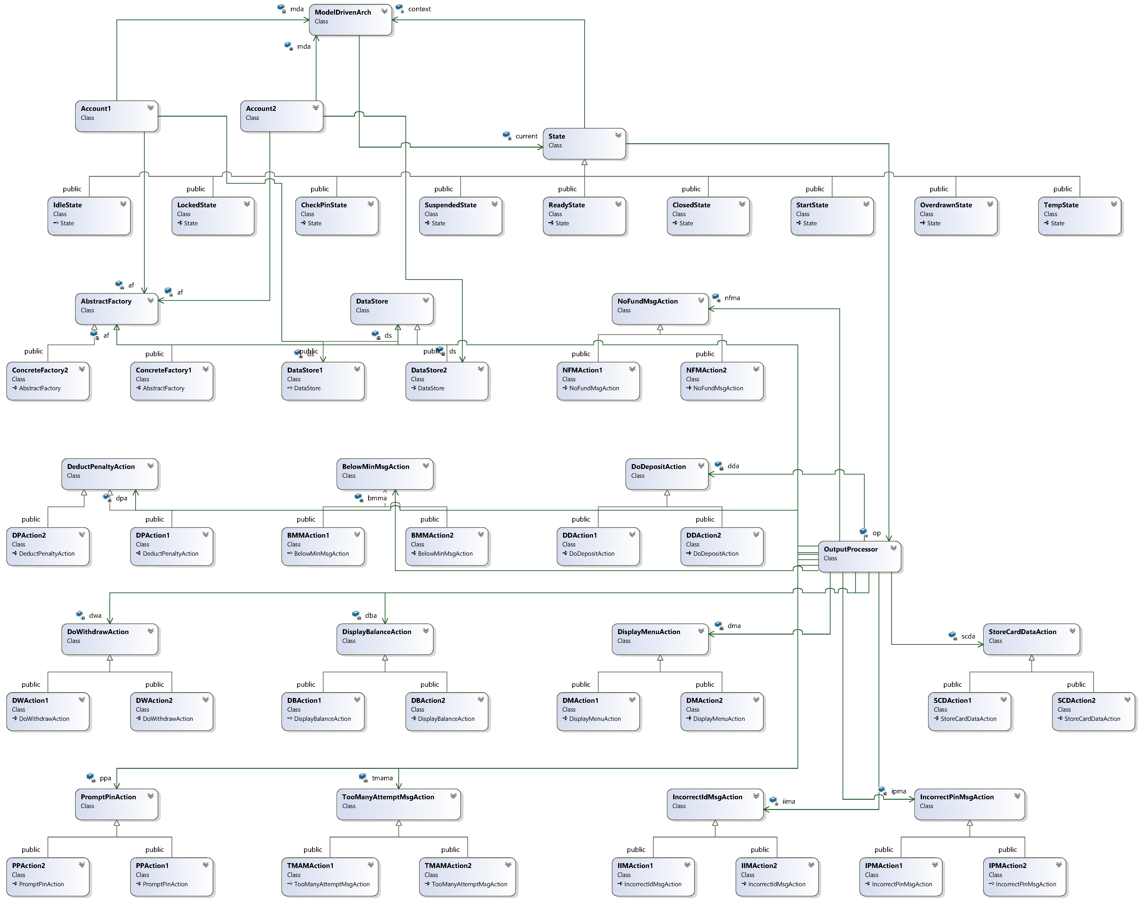
2. Class Diagrams of All Components
The overview architecture is drawn on the right diagram. It just shows the general relationships between various of classes. What missing here is the relationships between concrete factories and their corresponding products, e.g. concrete strategies and concrete DataStore objects, which is presented at Section 5. Abstract Factory Pattern II – Concrete Factories
3 class design patterns group classes by their responsibilities. In the following sections, I will introduce the software design group by group. Classes in each design are described in detail.

Slide 9
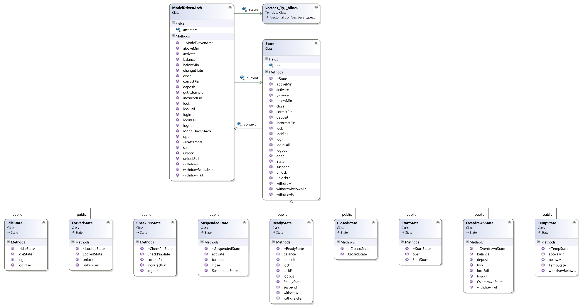
3. State Pattern
On the left is a zoomed and re-layouted diagram of state pattern.

Slide 10
3. State Pattern
Purpose, Attributes and Operations for State Pattern involved classes
Class ModelDrivenArch:
Purpose | Play the role of context class; keep tracking the current state in the EFSM; forward meta events to concrete states
Member variables | current: pointer to the object of current state attempts: number of incorrect PIN attempts states: a vector storing all state objects that appear in the state machine
Constructor | Create objects for each state in the state machine; store them in states; set current to StartState object
Destructor | Reclaim the objects in states
changeState(StateEnum id) | Used by State objects to change the current state of context
set/getAttempts() | Used by State objects to change/get the value of attempts
open() | Handle open event by calling current->open() | balance() | Handle balance event by calling current->balance()
login() | Handle login event by calling current->login() | withdraw() | Handle withdraw event by calling current->withdraw()
loginFail() | Handle loginFail event by calling current->loginFail() | withdrawFail() | Handle withdrawFail event by calling current->withdrawFail()
logout(int max) | Handle logout event by calling current->logout) | deposit() | Handle deposit event by calling current->deposit()
correctPin() | Handle correctPin event by calling current->correctPin() | lock() | Handle lock event by calling current->lock()
aboveMin() | Handle aboveMin event by calling current->aboveMin() | lockFail() | Handle lockFail event by calling current->lockFail()
belowMin() | Handle belowMin event by calling current->belowMin() | unlock() | Handle unlock event by calling current->unlock()
suspend() | Handle suspend event by calling current->suspend() | unlockFail() | Handle unlockFail event by calling current->unlockFail()
activate() | Handle activate event by calling current->activate() | close() | Handle close event by calling current->close()
incorrectPin(int max) | Handle incorrectPin event by calling current->incorrectPin(max) | withdrawBelowMin() | Handle withdrawBelowMin event by calling current->withdrawBelowMin()

Slide 11
3. State Pattern
Purpose, Attributes and Operations for State Pattern involved classes
Class: State
Purpose | Group all states appeared in the EFSM; define and provide default implementation of all event handler, e.g. do NOTHING
Member variables | context: pointer to the EFSM’s context, e.g. a ModelDrivenArch instance op: pointer to OutputProcessor instance for issuing action
Constructor | Initilize context and op with provided parameters
Destructor | No need to do anything
open() | Virtual function overridden by subclasses, empty operation | balance() | Virtual function overridden by subclasses, empty operation
login() | Virtual function overridden by subclasses, empty operation | withdraw() | Virtual function overridden by subclasses, empty operation
loginFail() | Virtual function overridden by subclasses, empty operation | withdrawFail() | Virtual function overridden by subclasses, empty operation
logout(int max) | Virtual function overridden by subclasses, empty operation | deposit() | Virtual function overridden by subclasses, empty operation
correctPin() | Virtual function overridden by subclasses, empty operation | lock() | Virtual function overridden by subclasses, empty operation
aboveMin() | Virtual function overridden by subclasses, empty operation | lockFail() | Virtual function overridden by subclasses, empty operation
belowMin() | Virtual function overridden by subclasses, empty operation | unlock() | Virtual function overridden by subclasses, empty operation
suspend() | Virtual function overridden by subclasses, empty operation | unlockFail() | Virtual function overridden by subclasses, empty operation
activate() | Virtual function overridden by subclasses, empty operation | close() | Virtual function overridden by subclasses, empty operation
incorrectPin(int max) | Virtual function overridden by subclasses, empty operation | withdrawBelowMin() | Virtual function overridden by subclasses, empty operation

Slide 12
3. State Pattern
Purpose, Attributes and Operations for State Pattern involved classes
Class: StartState
Purpose | Represent the Start state in EFSM; handle open event when current state is Start
Member variables | Inherit context and op from base class State
open() | Change current to Idle state, issue StoreData action to OutputProcessor op
Class: IdelState
Purpose | Represent the Idle state in EFSM; handle login and loginFail events when current state is Idle
Member variables | Inherit context and op from base class State
login() | Change current to CheckPin state, set context’s attempts to 0, issue PromptPin action to OutputProcessor op
loginFail() | Issue IncorrectIdMsg to OutputProcessor op
Class: CheckPinState
Purpose | Represent the CheckPin state in EFSM; handle correctPin, incorrectPin and logout events when current state is CheckPin
Member variables | Inherit context and op from base class State
correctPin() | Change current to Temp state, issue DisplayMenu action to OutputProcessor op
incorrectPin(int max) | If attempts >= max, reduce to Idle state and issue TooManyAttemptMsg action to OutputProcessor op; otherwise, increase context’s attempts by one and issue IncorrectPinMsg action to OutputProcessor op
logout() | Change current to Idle state

Slide 13
3. State Pattern
Purpose, Attributes and Operations for State Pattern involved classes
Class: ReadyState
Purpose | Represent the Ready state in EFSM; handle events illustrated in the EFSM figure
Member variables | Inherit context and op from base class State
balance() | Issue DisplayBalance action to OutputProcessor op
lockFail() | Issue IncorrectPinMsg action to OutputProcessor op
lock() | Change current to Locked state
suspend() | Change current to Suspended state
withdrawFail() | Issue NoFundMsg action to OutputProcessor op
withdraw() | Change current to Temp state, issue DoWithdraw action to OutputProcessor op
deposit() | Issue DoDeposit action to OutputProcessor op
logout() | Change current to Idle state

Slide 14
3. State Pattern
Purpose, Attributes and Operations for State Pattern involved classes
Class: OverdrawnState
Purpose | Represent the Overdrawn state in EFSM; handle events illustrated in the EFSM figure
Member variables | Inherit context and op from base class State
balance() | Issue DisplayBalance action to OutputProcessor op
lockFail() | Issue IncorrectPinMsg action to OutputProcessor op
lock() | Change current to Locked state
withdrawFail() | Issue BelowMinMsg action to OutputProcessor op
deposit() | Change current to Temp state, issue DoDeposit action to OutputProcessor op
logout() | Change current to Idle state
Class: LockedState
Purpose | Represent the Locked state in EFSM; handle unlock and unlockFail events when current state is Idle
Member variables | Inherit context and op from base class State
unlock() | Change current to Temp state
unlockFail() | Issue IncorrectPinMsg to OutputProcessor op

Slide 15
3. State Pattern
Purpose, Attributes and Operations for State Pattern involved classes
Class: SuspendedState
Purpose | Represent the Suspended state in EFSM; handle activate, balance and close events illustrated in the EFSM figure
Member variables | Inherit context and op from base class State
balance() | Issue DisplayBalance action to OutputProcessor op
activate() | Change current to Ready state
close() | Change current to Closed state
Class: TempState
Purpose | Represent the Temp state in EFSM; handle aboveMin, belowMin and withdrawBelowMin events when current state is Idle
Member variables | Inherit context and op from base class State
aboveMin() | Change current to Ready state
belowMin() | Change current to Overdrawn state
withdrawBelowMin() | Change current to Overdrawn state, issue Penalty action to OutputProcessor op

Slide 16
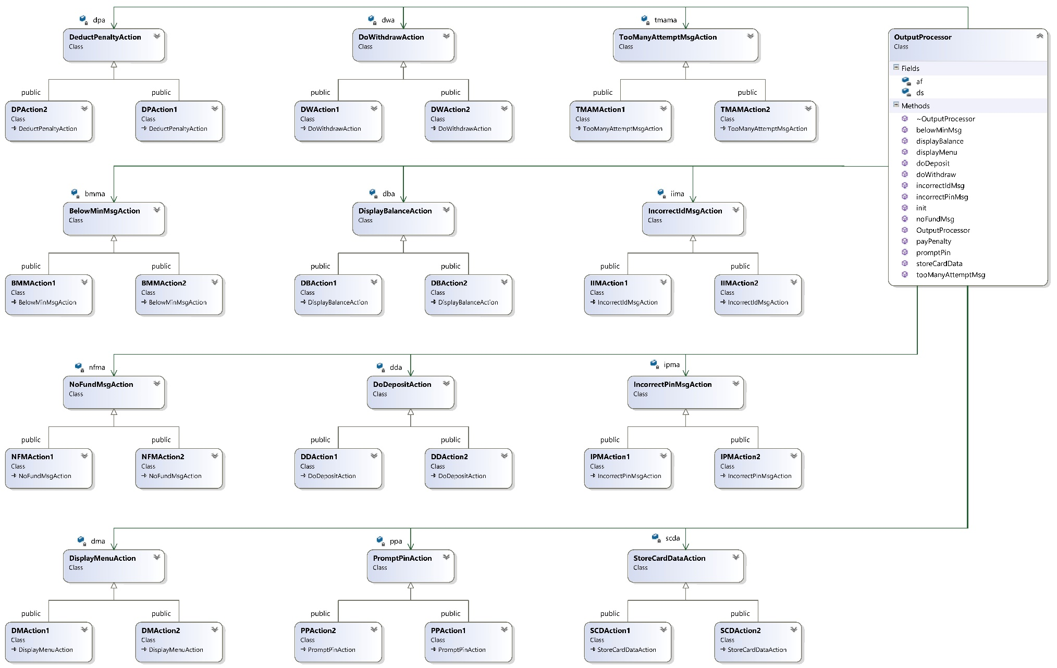
4. Strategy Pattern
On the left is a zoomed out diagram of strategy pattern. Each action corresponds to a strategy.

Slide 17
4. Strategy Pattern
Purpose, Attributes and Operations for Strategy Pattern involved classes
Class: OutputProcessor
Purpose | Play the role of output processor in MDA architecture; as client of various action strategies, issue actions on each strategy’s base class
Member variables | ds: point to a DataStore object; some actions need a DataStore object to access data |  |  | dpa: pinter to DeductPenaltyAction strategy
 | sda: pointer to StoreDataAction strategy |  |  | ipma: pointer to IncorrectPinMsgAction strategy
 | iimp: pointer to IncorrectIdMsgAction strategy |  |  | tmama: pointer to TooManyAttmeptAction strategy
 | ppa: pointer to PromptPinAction strategy |  |  | dma: pointer to DisplayMenuAction strategy
 | dda: pointer to DoDepositAction strategy |  |  | nfma: pointer to NoFundMsaAction strategy
 | dba: pointer to DoWithdrawAction strategy |  |  | bmma: pointer to BelowMinMsgAction strategy
 | af: Abstract factory instance used to create/configure all the previous pointers
Constructor(AbstractFacotry *af) | Initialize af with a concrete factory | Destructor() |  |  |  | Do nothing
init() | Create/configure DataStore object and action strategies using af, see Abstract Factory Pattern for details
storeData() | Forward action by invoking sda->storeData() |  | doDeposit() |  | Forward action by invoking dda->doDeposit()
incorrecePinMsg() | Forward action by invoking ipma>incorrecePinMsg() |  | noFundMsg() |  | Forward action by invoking nfma->noFundMsg()
incorrectIdMsg() | Forward action by invoking iima->incorrecePinMsg() |  | displayBalance() |  | Forward action by invoking dba->displayBalance()
tooManyAttemptMsg() | Forward action by invoking tmama->tooManyAttemptMsg() |  | doWithdraw() |  | Forward action by invoking dwm->doWithdraw()
promptPin() | Forward action by invoking ppa->promptPin() |  | belowMinMsg() |  | Forward action by invoking bmma->belowMinMsg()
displayMenu() | Forward action by invoking dma->displayMenu() |  | payPenalty() |  | Forward action by invoking dpa->payPenalty()

Slide 18
4. Strategy Pattern
Purpose, Attributes and Operations for Strategy Pattern involved classes
Class: StoreDataAction
Purpose | Abstract class that groups strategies of StoreData action
Member variables | None
Constructor/Destructor() | Do nothing
storeData(DataStore *ds) | Abstract method; subclass should override it to store temp_pin, temp_id and temp_balance to pin, id and balance respectively; different strategies differs in the type of DataStore
Class: SDAction1
Purpose | Concrete strategy of StoreData action for Account1
Member variables | None
Constructor/Destructor() | Do nothing
storeData(DataStore *ds) | Cast ds to DataStore1 object and execute the store action
Class: SDAction2
Purpose | Concrete strategy of StoreData action for Account2
Member variables | None
Constructor/Destructor() | Do nothing
storeData(DataStore *ds) | Cast ds to DataStore2 object and execute the store action

Slide 19
4. Strategy Pattern
Purpose, Attributes and Operations for Strategy Pattern involved classes
Class: IncorrectPinMsgAction
Purpose | Abstract class that groups strategies of IncorrectPinMsg action
Member variables | None
Constructor/Destructor() | Do nothing
incorrectPinMsg() | Abstract method; override to print out msg about incorrect PIN number for different accounts
Class: IPMAction1
Purpose | Concrete strategy of IncorrectPinMsg action for Account1
Member variables | None
Constructor/Destructor() | Do nothing
incorrectPinMsg() | Print out incorrect PIN msg for account1
Class: IPMAction2
Purpose | Concrete strategy of IncorrectPinMsg action for Account2
Member variables | None
Constructor/Destructor() | Do nothing
incorrectPinMsg() | Print out incorrect PIN msg for account2

Slide 20
4. Strategy Pattern
Purpose, Attributes and Operations for Strategy Pattern involved classes
Class: IncorrectIdMsgAction
Purpose | Abstract class that groups strategies of IncorrectIdMsg action
Member variables | None
Constructor/Destructor() | Do nothing
incorrectIdMsg() | Abstract method; override to print out msg about incorrect ID number for different accounts
Class: IIMAction1
Purpose | Concrete strategy of IncorrectIdMsg action for Account1
Member variables | None
Constructor/Destructor() | Do nothing
incorrectIdMsg() | Print out incorrect ID msg for account1
Class: IIMAction2
Purpose | Concrete strategy of IncorrectIdMsg action for Account2
Member variables | None
Constructor/Destructor() | Do nothing
incorrectIdMsg() | Print out incorrect ID msg for account2

Slide 21
4. Strategy Pattern
Purpose, Attributes and Operations for Strategy Pattern involved classes
Class: TooManyAttemptMsgAction
Purpose | Abstract class that groups strategies of TooManyAttemptMsg action
Member variables | None
Constructor/Destructor() | Do nothing
tooManyAttemptMsg() | Abstract method; override to print out msg about “too many incorrect PIN number” for different accounts
Class: TMAMAction1
Purpose | Concrete strategy of TooManyAttemptMsg action for Account1
Member variables | None
Constructor/Destructor() | Do nothing
tooManyAttemptMsg() | Print out too many incorrect PIN number msg for account1
Class: TMAMAction2
Purpose | Concrete strategy of TooManyAttemptMsg action for Account2
Member variables | None
Constructor/Destructor() | Do nothing
tooManyAttemptMsg() | Print out too many incorrect PIN number msg for account2

Slide 22
4. Strategy Pattern
Purpose, Attributes and Operations for Strategy Pattern involved classes
Class: PromptPinAction
Purpose | Abstract class that groups strategies of PromptPin action
Member variables | None
Constructor/Destructor() | Do nothing
promptPin() | Abstract method; override to print out msg about “please input PIN number” for different accounts
Class: PPAction1
Purpose | Concrete strategy of PromptPin action for Account1
Member variables | None
Constructor/Destructor() | Do nothing
promptPin() | Print out “please input PIN number” msg for account1
Class: PPAction2
Purpose | Concrete strategy of PromptPin action for Account2
Member variables | None
Constructor/Destructor() | Do nothing
promptPin() | Print out “please input PIN number” msg for account2

Slide 23
4. Strategy Pattern
Purpose, Attributes and Operations for Strategy Pattern involved classes
Class: DisplayMenuAction
Purpose | Abstract class that groups strategies of DisplayMenu action
Member variables | None
Constructor/Destructor() | Do nothing
displayMenu() | Abstract method; override to print menu for different accounts
Class: DMAction1
Purpose | Concrete strategy of DisplayMenu action for Account1
Member variables | None
Constructor/Destructor() | Do nothing
displayMenu() | Print out menu for account1
Class: DMAction2
Purpose | Concrete strategy of DisplayMenu action for Account2
Member variables | None
Constructor/Destructor() | Do nothing
displayMenu() | Print out menu for account2

Slide 24
4. Strategy Pattern
Purpose, Attributes and Operations for Strategy Pattern involved classes
Class: DoDepositAction
Purpose | Abstract class that groups strategies of DoDeposit action
Member variables | None
Constructor/Destructor() | Do nothing
doDeposit(DataStore *ds) | Abstract method; override to make deposit with temp_d and balance in DataStore
Class: DDAction1
Purpose | Concrete strategy of DoDeposit action for Account1
Member variables | None
Constructor/Destructor() | Do nothing
doDeposit(DataStore *ds) | Make deposit by adding temp_d and balance in DataStore
Class: DDAction2
Purpose | Concrete strategy of DoDeposit action for Account2
Member variables | None
Constructor/Destructor() | Do nothing
doDeposit(DataStore *ds) | Make deposit by adding temp_d and balance in DataStore

Slide 25
4. Strategy Pattern
Purpose, Attributes and Operations for Strategy Pattern involved classes
Class: NoFundMsgAction
Purpose | Abstract class that groups strategies of NoFundMsg action
Member variables | None
Constructor/Destructor() | Do nothing
noFundMsg() | Abstract method; override to prompt msg about insufficient fund
Class: NFMAction1
Purpose | Concrete strategy of NoFundMsg action for Account1
Member variables | None
Constructor/Destructor() | Do nothing
doDeposit() | Prompt msg about insufficient fund
Class: NFMAction2
Purpose | Concrete strategy of NoFundMsg action for Account2
Member variables | None
Constructor/Destructor() | Do nothing
doDeposit() | Prompt msg about insufficient fund

Slide 26
4. Strategy Pattern
Purpose, Attributes and Operations for Strategy Pattern involved classes
Class: DisplayBalanceAction
Purpose | Abstract class that groups strategies of DisplayBalance action
Member variables | None
Constructor/Destructor() | Do nothing
displayBalance(DataStore *ds) | Abstract method; override to display current balance for different accounts
Class: DBAction1
Purpose | Concrete strategy of DisplayBalance action for Account1
Member variables | None
Constructor/Destructor() | Do nothing
displayBalance(DataStore *ds) | display current balance for account 1
Class: DBAction2
Purpose | Concrete strategy of DisplayBalance action for Account2
Member variables | None
Constructor/Destructor() | Do nothing
displayBalance(DataStore *ds) | display current balance for account 2

Slide 27
4. Strategy Pattern
Purpose, Attributes and Operations for Strategy Pattern involved classes
Class: DoWithdrawAction
Purpose | Abstract class that groups strategies of DoWithdraw action
Member variables | None
Constructor/Destructor() | Do nothing
doWithdraw(DataStore *ds) | Abstract method; override to make withdraw from temp_w from balance
Class: DWAction1
Purpose | Concrete strategy of DoWithdraw action for Account1
Member variables | None
Constructor/Destructor() | Do nothing
doWithdraw(DataStore *ds) | Make withdraw from temp_w from balance
Class: DWAction2
Purpose | Concrete strategy of DoWithdraw action for Account2
Member variables | None
Constructor/Destructor() | Do nothing
doWithdraw(DataStore *ds) | Make withdraw from temp_w from balance

Slide 28
4. Strategy Pattern
Purpose, Attributes and Operations for Strategy Pattern involved classes
Class: BelowMinMsgAction
Purpose | Abstract class that groups strategies of BelowMinMsg action
Member variables | None
Constructor/Destructor() | Do nothing
belowMinMsg() | Abstract method; override to print out msg about below minimum balance
Class: DWAction1
Purpose | Concrete strategy of BelowMinMsg action for Account1
Member variables | None
Constructor/Destructor() | Do nothing
belowMinMsg() | Print out msg about below minimum balance
Class: DWAction2
Purpose | Concrete strategy of BelowMinMsg action for Account2
Member variables | None
Constructor/Destructor() | Do nothing
belowMinMsg() | Print out msg about below minimum balance

Slide 29
4. Strategy Pattern
Purpose, Attributes and Operations for Strategy Pattern involved classes
Class: DeductPenaltyAction
Purpose | Abstract class that groups strategies of DeductPenalty action
Member variables | penalty: amount of penalty to pay for different accounts
Constructor/Destructor() | Do nothing
payPenalty(DataStore *ds) | Abstract method; override to deduct penalty from balance
Class: DPAction1
Purpose | Concrete strategy of BelowMinMsg action for Account1
Member variables | Inherit penalty from base class
Constructor/Destructor() | Do nothing
payPenalty(DataStore *ds) | Deduct penalty from balance, penalty for Account1 is 20
Class: DPAction2
Purpose | Concrete strategy of BelowMinMsg action for Account2
Member variables | Inherit penalty from base class
Constructor/Destructor() | Do nothing
payPenalty(DataStore *ds) | Deduct penalty from balance, penalty for Account2 is zero

Slide 30
5. Abstract Factory Pattern I – AbstractFactory
Class diagram of abstract factory pattern, showing the relation between abstract factory and its clients(InputProcessor and OutputProcessors), but without showing the relations between concrete factories and its products.

Slide 31
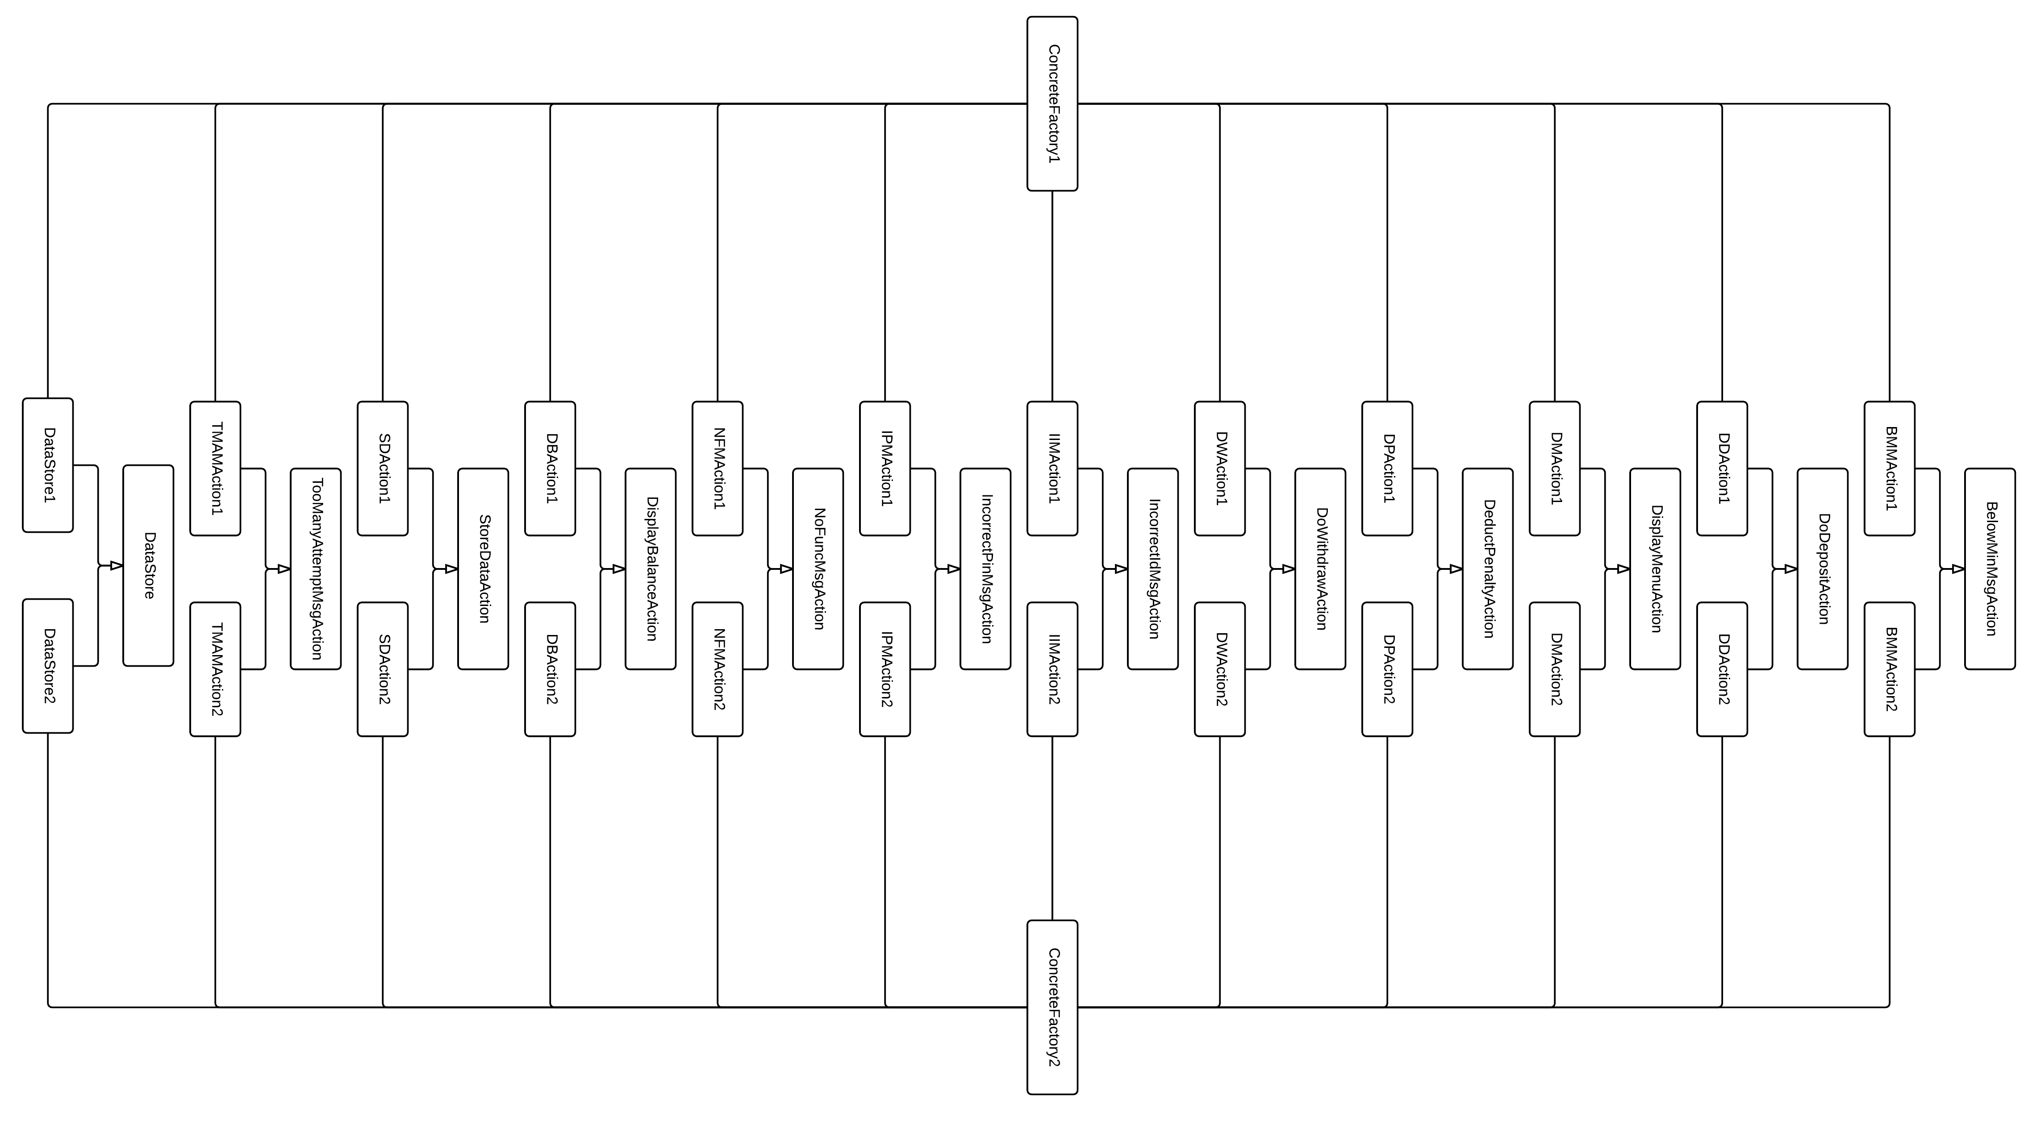
5. Abstract Factory Pattern II – Concrete Factories
Simplified class diagram of abstract factory pattern showing the relationships between concrete factories and its products.

Slide 32
5. Abstract Factory Pattern
Purpose, Attributes and Operations for Abstract Factory Pattern involved classes
Class: AbstractFactory
Purpose | Groups various of concrete factories for different clients (InputProcessors and OutpurProcessor)
Member variables Notice: since InputProcessor and OutputProcessor should operate on the same DataStore instance, AbstractFactory should only create 1 such object and cache it for later usage. | cacheDS: pointer to a DataStore object; | cacheDPA: pinter to DeductPenaltyAction strategy
 | cacheSDA: pointer to StoreDataAction strategy | cacheIPMA: pointer to IncorrectPinMsgAction strategy
 | cacheIIMP: pointer to IncorrectIdMsgAction strategy | cacheTMAMA: pointer to TooManyAttmeptAction strategy
 | cachePPA: pointer to PromptPinAction strategy | cacheDMA: pointer to DisplayMenuAction strategy
 | cacheDDA: pointer to DoDepositAction strategy | cacheNFMA: pointer to NoFundMsaAction strategy
 | cacheDWA: pointer to DoWithdrawAction strategy | cacheBMMA: pointer to BelowMinMsgAction strategy
Constructor() | Initialize all pointers above to NULL | Destructor() | Do nothing
createDS() | Abstract method returning DataStore instance to client
createSDA() | Abstract method returning StoreCardAction strategy | createDDA() | Abstract method returning DoDepositAction strategy
createIPMA() | Abstract method returning IncorrectPinMsgAction strategy | createNFMA() | Abstract method returning NoFundMsgAction strategy
createIIMA() | Abstract method returning IncorrectIdMsgAction strategy | createDBA() | Abstract method returning DisplayBalanceAciton strategy
createTMAMA() | Abstract method returning IncorrectIdMsgAction strategy | createDWA() | Abstract method returning DoWithdrawAction strategy
createPPA() | Abstract method returning PromptPinAciton strategy | createBMMA() | Abstract method returning BelowMinMsgAction strategy
createDMA() | Abstract method returning DisplayMenuAction strategy | createDPA() | Abstract method returning DeductPenaltyAction strategy

Slide 33
5. Abstract Factory Pattern
Purpose, Attributes and Operations for Abstract Factory Pattern involved classes
Class: ConcreteFactory1
Purpose | Concrete factory who create strategies and DataStore1 instance for Account1 and its paired OutputProcessor
Member variables | Cache pointers inherited from AbstractFactory base class
Constructor() | Do nothing (use base class’s constructor) | Destructor() | Do nothing
createDS() | Create DataStore1 instance, cache it before return it to client; thereafter return the cached instance
createSDA() | Create SDAction1 instance, cache it before return it to client; thereafter return the cached instance
createIPMA() | Create IPMAction1 instance, cache it before return it to client; thereafter return the cached instance
createIIMA() | Create IIMAction1 instance, cache it before return it to client; thereafter return the cached instance
createTMAMA() | Create TMAMAction1 instance, cache it before return it to client; thereafter return the cached instance
createPPA() | Create PPAction1 instance, cache it before return it to client; thereafter return the cached instance
createDMA() | Create DMAction1 instance, cache it before return it to client; thereafter return the cached instance
createDDA() | Create DDAction1 instance, cache it before return it to client; thereafter return the cached instance
createNFMA() | Create NFMAction1 instance, cache it before return it to client; thereafter return the cached instance
createDBA() | Create DBAction1 instance, cache it before return it to client; thereafter return the cached instance
createDWA() | Create DWAction1 instance, cache it before return it to client; thereafter return the cached instance
createBMMA() | Create BMMAction1 instance, cache it before return it to client; thereafter return the cached instance
createDPA() | Create DPAction1 instance, cache it before return it to client; thereafter return the cached instance

Slide 34
5. Abstract Factory Pattern
Purpose, Attributes and Operations for Abstract Factory Pattern involved classes
Class: ConcreteFactory1
Purpose | Concrete factory who create strategies and DataStore2 instance for Account2 and its paired OutputProcessor
Member variables | Cache pointers inherited from AbstractFactory base class
Constructor() | Do nothing (use base class’s constructor) | Destructor() | Do nothing
createDS() | Create DataStore2 instance, cache it before return it to client; thereafter return the cached instance
createSDA() | Create SDAction2 instance, cache it before return it to client; thereafter return the cached instance
createIPMA() | Create IPMAction2 instance, cache it before return it to client; thereafter return the cached instance
createIIMA() | Create IIMAction2 instance, cache it before return it to client; thereafter return the cached instance
createTMAMA() | Create TMAMAction2 instance, cache it before return it to client; thereafter return the cached instance
createPPA() | Create PPAction2 instance, cache it before return it to client; thereafter return the cached instance
createDMA() | Create DMAction2 instance, cache it before return it to client; thereafter return the cached instance
createDDA() | Create DDAction2 instance, cache it before return it to client; thereafter return the cached instance
createNFMA() | Create NFMAction2 instance, cache it before return it to client; thereafter return the cached instance
createDBA() | Create DBAction2 instance, cache it before return it to client; thereafter return the cached instance
createDWA() | Create DWAction2 instance, cache it before return it to client; thereafter return the cached instance
createBMMA() | Create BMMAction2 instance, cache it before return it to client; thereafter return the cached instance
createDPA() | Create DPAction2 instance, cache it before return it to client; thereafter return the cached instance

Slide 35
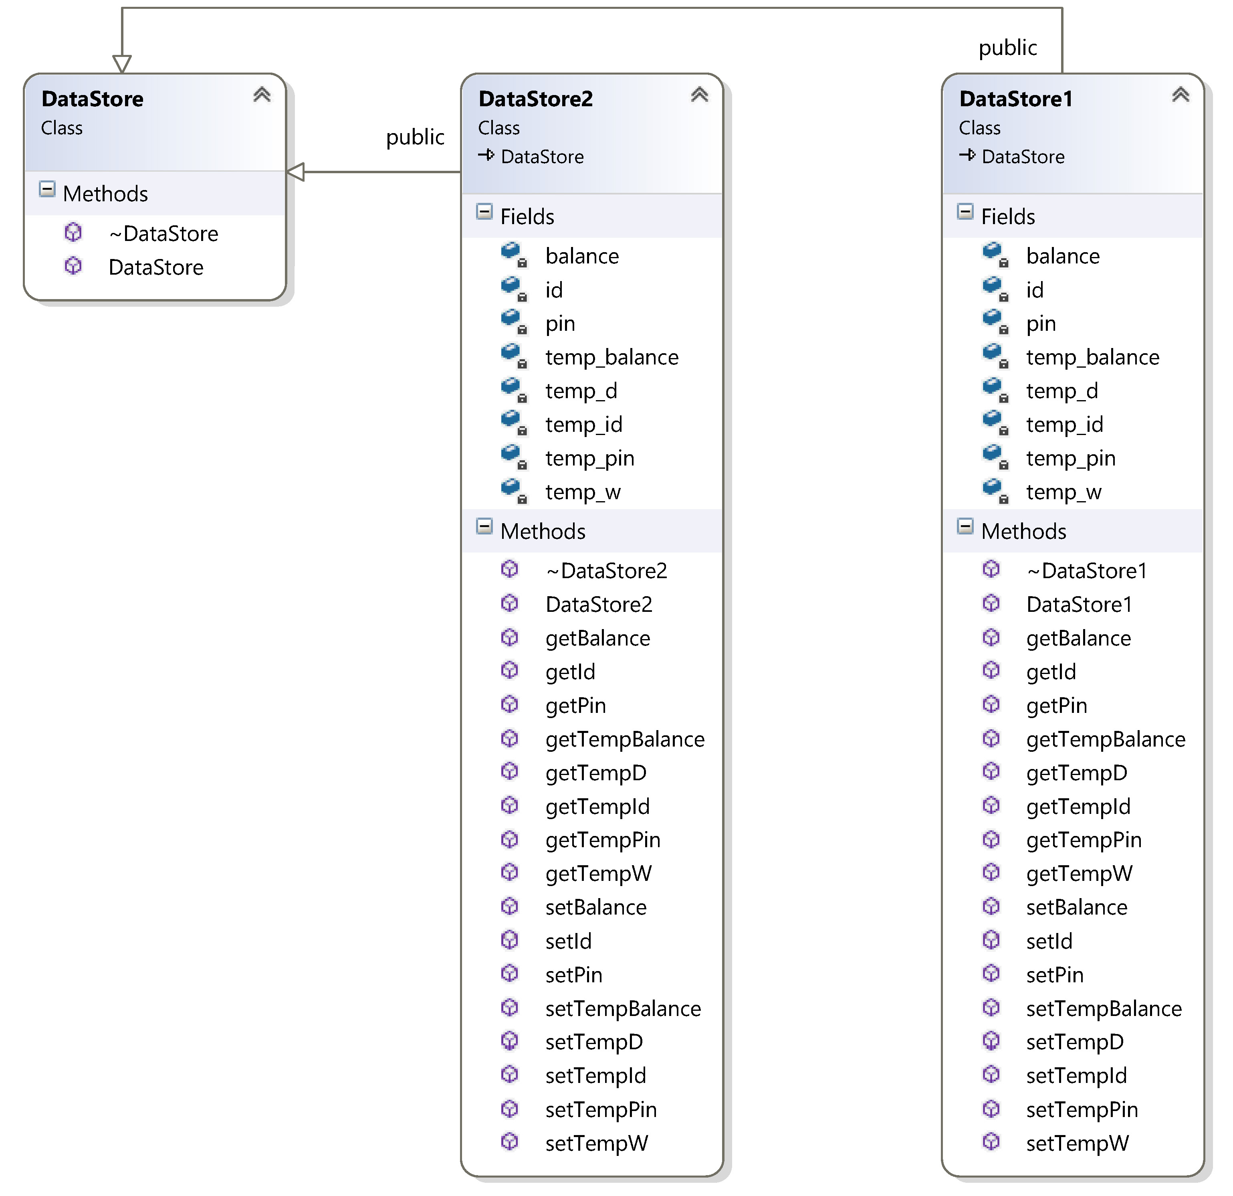
6. Details for Other Classes: DataStore
Class: DataStore
Purpose | Groups different accounts’ data
Class: DataStore1
Purpose | Data store used in implementing Account1’s logic
Member variables | balance: float type, represent account balance id: string type, represent account id pin: string type, represent PIN number temp_balance: float type, temporal data used for open() temp_pin: string type, temporal data used for open() temp_id: string type, temporal data used for open() temp_d: float type, temporal data used for deposit() temp_w: float type, temporal data used for withdraw()
Operations | Various getter and setter for member variables
Class: DataStore1
Purpose | Data store used in implementing Account2’s logic
Member variables | balance: int type, represent account balance id: int type, represent account id pin: int type, represent PIN number temp_balance: int type, temporal data used for open() temp_pin: int type, temporal data used for open() temp_id: int type, temporal data used for open() temp_d: int type, temporal data used for deposit() temp_w: int type, temporal data used for withdraw()
Operations | Various getter and setter for member variables

Slide 36
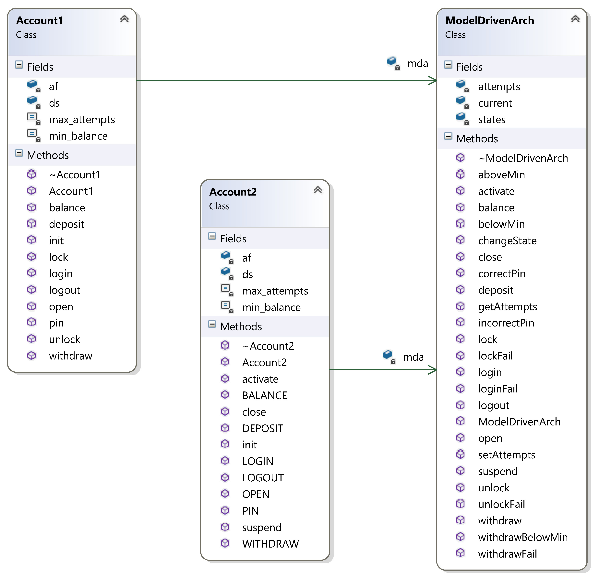
6. Details for Other Classes: Accounts
Class: Account1
Purpose | Play the role of InputProcessor in Model-driven architecture
Member variables | mda: pointer to ModelDrivenArch instance af: pointer to an AbstractFactory instance ds: pointer to its DataStore instance max_attempts: maximum number of incorrect PIN allowed min_balance: minimum balance amount
Constructor() | Initialize mda, af, max_attempts and min_balance
Destructor() | Reclaim/free DataStore1 object ds
Operations | Events in Account1-EFSM; each operation’s pseudo code is shown in section 1, page 5.
Class: Account2
Purpose | Play the role of InputProcessor in Model-driven architecture
Member variables | mda: pointer to ModelDrivenArch instance af: pointer to an AbstractFactory instance ds: pointer to its DataStore instance max_attempts: maximum number of incorrect PIN allowed min_balance: minimum balance amount
Constructor() | Initialize mda, af, max_attempts and min_balance
Destructor() | Reclaim/free DataStore2 object ds
Operations | Events in Account2-EFSM; each operation’s pseudo code is shown in section 1, page 6.

Slide 37
7. Dynamics for Two Scenarios
Scenario 1, open(abc, xyz, 100.5)

Slide 38
7. Dynamics for Two Scenarios
Scenario 1, login(xyz)

Slide 39
7. Dynamics for Two Scenarios
Scenario 1, pin(abc)

Slide 40
7. Dynamics for Two Scenarios
Scenario 1, deposit(400)

Slide 41
7. Dynamics for Two Scenarios
Scenario 1, balance()

Slide 42
7. Dynamics for Two Scenarios
Scenario 1, logout()

Slide 43
7. Dynamics for Two Scenarios
Scenario 2, OPEN()

Slide 44
7. Dynamics for Two Scenarios
Scenario 2, LOGIN()

Slide 45
7. Dynamics for Two Scenarios
Scenario 2, PIN(112)

Slide 46
7. Dynamics for Two Scenarios
Scenario 2, PIN(222)

Slide 47
7. Dynamics for Two Scenarios
Scenario 2, PIN(333)

Slide 48
8. Source Code and Patterns
State Pattern
State pattern is used for maintaining the state transition of MDA-EFSM. Its implementation locates at include/ModelDriveArch.hpp and src/ModelDriveArch.cpp. The classes involved in state pattern are:
ModelDrivenArch class: state machine context. since decentralized state pattern is used, this class delegate all events handling to the state classes.
State class: parent of all states class; it provides default event handling, e.g. do nothing.
Concrete state classes, including StartState, IdleState, CheckPinState, ReadyState, OverdrawnState, LockedState, SuspendedState, CloseState and TempState

Slide 49
8. Source Code and Patterns
Strategy Pattern
Strategy pattern groups the actions of different accounts. Its implementation locates at include/Actions.hpp and src/Actions.cpp. The classes involved in strategy pattern are:
Each meta action corresponds to an abstract strategy class, including StoreCardDataAction, IncorrectPinMsgAction, IncorrectIdMsgAction, TooManyAttemptMsgAction, PromptPinAction, DisplayMenuAction, DoDepositAction, NoFundMsgAction, DisplayBalanceAction, DoWithdrawAction, BelowMinMsgAction, DeductPenaltyAction
For each strategy, 2 concrete strategies are provided for either Account1 or Account2, including SCDAction1, SCDAction2, IPMAction1, IPMAction2, IIMAction1, IIMAction2, TMAMAction1, TMAMAction2, PPAction1, PPAction2, DMAction1, DMAction2, DDAction1, DDAction2, NFMAction1, NFMAction2, DBAction1, DBAction2, DWAction1, DWAction2, BMMAction1, BMMAction2, DPAction1, DPAction2
OutputProcessor: the client class of strategies

Slide 50
8. Source Code and Patterns
Abstract Factory Pattern
Abstract factory pattern eases the burden of create and configure strategies and data store for clients. Its implementation locates at include/AbstractFactory.hpp and src/AbstractFactory.cpp. Client of abstract factory are InputProcessors and Outprocessor, located at include/Accounts.hpp, includes/Actions.hpp, src/Accounts.cpp and src/Actions.cpp. The classes involved in strategy pattern are:
AbstractFactory class: defines the possible products could be created for its clients
ConcreteFactory1 and ConcreteFactory2 classes: concrete classes for Account1 and Account2 respectively.
Account1, Account2 and OutputProcessor classes: client of AbstractFactory
Concrete products created by concrete factories:
For Account1 and OutputProcessor: DataStore1, SCDAction1, IPMAction1, IIMAction1, TMAMAction1, PPAction1, DMAction1, DDAction1, NFMAction1, DBAction1, DWAction1, BMMAction1, DPAction1
For Account2 and OutputProcessor: DataStore2, SCDAction2, IPMAction2, IIMAction2, TMAMAction2, PPAction2, DMAction2, DDAction2, NFMAction2, DBAction2, DWAction2, BMMAction2, DPAction2

Slide 51
9. Source Code
This section presents the C++ source code. The project is developed under CLion and Vim. To make it be able to compile under various OS platform, I choose to use CMake. The CMakeList.txt file is used to generate Makefile. There are 3 major directory. Class declaration files (header files) are in include; implementation of all classes are in .cpp files under src directory. Built binary executable are in build, which also contains generated Makefile. To rebuild the project, simple use the following commands:
cd build # change to build directory
cmake .. # generate build scripts
make # complie, link and build executable main
There are 5 files under include: Accounts.hpp, AbstractFactory.hpp, Actions.hpp, ModelDrivenArch.hpp, DataStore.hpp. Correspondingly, there are 5 files under src: Accounts.cpp, AbstractFactory.cpp, Actions.cpp, ModelDrivenArch.cpp, main.cpp. Source code are presented in pair of (xxxx.hpp, xxxx.cpp).
There is also a README.md file explaining how to build and run the program. Basically, I adopt the sample driver to run Account1 and Account2. You should be able to run the program as the professor runs the in-class demo.

Slide 52
9. Source Code: Demo
Screenshot of running scenarios 1
BankAccount Version 1.0
Please choose the type of ACCOUNT
1. ACCOUNT-1
2. ACCOUNT-2
q. Quit the demo program
1
ACCOUNT-1
MENU of Operations
0. open(string, string, float)
1. login(string)
2. pin(string)
3. deposit(float)
4. withdraw(float)
5. balance()
6. logout()
7. lock(string)
8. unlock(string)
q. Quit ACCOUNT-1
ACCOUNT-1 Execution
Select Operation:
0-open, 1-login, 2-pin, 3-deposit, 4-withdraw, 5-balance, 6-logout, 7-lock, 8-unlock
0
Operation: open(string p, string y, float a)
Enter value of the parameter p:
abc
Enter value of the parameter y:
xyz
Enter value of the parameter a:
100.5
Select Operation:
0-open, 1-login, 2-pin, 3-deposit, 4-withdraw, 5-balance, 6-logout, 7-lock, 8-unlock
1
Operation: login(string y)
Enter value of the parameter y:
xyz
Please Input PIN to Proceed at Account1
Select Operation:
0-open, 1-login, 2-pin, 3-deposit, 4-withdraw, 5-balance, 6-logout, 7-lock, 8-unlock
2
Operation: pin(string x)
Enter value of the parameter x
abc
Menu at Account1
1. Display Balance
2. Make Deposit
3. Withdraw
4. Lock Account
5. Unlock Account
6. Logout
Select Operation:
0-open, 1-login, 2-pin, 3-deposit, 4-withdraw, 5-balance, 6-logout, 7-lock, 8-unlock
3
Operation: deposit(float d)
Enter value of the parameter d:
400
Select Operation:
0-open, 1-login, 2-pin, 3-deposit, 4-withdraw, 5-balance, 6-logout, 7-lock, 8-unlock
5
Operation: balance()
Current Balance = $500.5 at Account1
Select Operation:
0-open, 1-login, 2-pin, 3-deposit, 4-withdraw, 5-balance, 6-logout, 7-lock, 8-unlock
6
Operation: logout()
Select Operation:
0-open, 1-login, 2-pin, 3-deposit, 4-withdraw, 5-balance, 6-logout, 7-lock, 8-unlock
q
Please choose the type of ACCOUNT
1. ACCOUNT-1
2. ACCOUNT-2
q. Quit the demo program

Slide 53
9. Source Code: Demo
Screenshot of running scenarios 2
BankAccount Version 1.0
Please choose the type of ACCOUNT
1. ACCOUNT-1
2. ACCOUNT-2
q. Quit the demo program
2
ACCOUNT-2
MENU of Operations
0. OPEN(int,int,int)
1. LOGIN(int)
2. PIN(int)
3. DEPOSIT(int)
4. WITHDRAW(int)
5. BALANCE()
6. LOGOUT()
7. suspend()
8. activate()
9. close()
q. Quit ACCOUNT-2
ACCOUNT-2 Execution
Select Operation:
0-OPEN, 1-LOGIN, 2-PIN, 3-DEPOSIT, 4-WITHDRAW, 5-BALANCE, 6-LOGOUT, 7-suspend, 8-activate, 9-close
0
Operation: OPEN(int p, int y, int a)
Enter value of the parameter p:
123
Enter value of the parameter y:
111
Enter value of the parameter a:
1000
Select Operation:
0-OPEN, 1-LOGIN, 2-PIN, 3-DEPOSIT, 4-WITHDRAW, 5-BALANCE, 6-LOGOUT, 7-suspend, 8-activate, 9-close
1
Operation: LOGIN(int y)
Enter value of the parameter y:
111
Please Input PIN to Proceed at Account2
Select Operation:
0-OPEN, 1-LOGIN, 2-PIN, 3-DEPOSIT, 4-WITHDRAW, 5-BALANCE, 6-LOGOUT, 7-suspend, 8-activate, 9-close
2
Operation: PIN(int x)
Enter value of the parameter x
112
Incorrect Pin Input at Account 2
Select Operation:
0-OPEN, 1-LOGIN, 2-PIN, 3-DEPOSIT, 4-WITHDRAW, 5-BALANCE, 6-LOGOUT, 7-suspend, 8-activate, 9-close
2
Operation: PIN(int x)
Enter value of the parameter x
222
Incorrect Pin Input at Account 2
Select Operation:
0-OPEN, 1-LOGIN, 2-PIN, 3-DEPOSIT, 4-WITHDRAW, 5-BALANCE, 6-LOGOUT, 7-suspend, 8-activate, 9-close
2
Operation: PIN(int x)
Enter value of the parameter x
333
#Attempts Exceed Maximum Allowed at Account2
Select Operation:
0-OPEN, 1-LOGIN, 2-PIN, 3-DEPOSIT, 4-WITHDRAW, 5-BALANCE, 6-LOGOUT, 7-suspend, 8-activate, 9-close
q
Please choose the type of ACCOUNT
1. ACCOUNT-1
2. ACCOUNT-2
q. Quit the demo program
q

Slide 54
9. Source Code: Accounts.hpp
/** * Declaration of two different logic/implementation: * Account1 and Account2, as Input Processor in Model- * driven Architecture */ #ifndef _ACCOUNTS_HPP #define _ACCOUNTS_HPP #include "ModelDrivenArch.hpp" #include "DataStore.hpp" class AbstractFactory; class Account1 { private: ModelDrivenArch *mda; DataStore1 *ds; AbstractFactory *af; const int min_balance; /* minimum balance */ const int max_attempts; /* max number of PIN attempts */ public: Account1(ModelDrivenArch *m, AbstractFactory *a, int mb = 500, int ma = 3): mda(m), af(a), min_balance(mb), max_attempts(ma) {}; virtual ~Account1() { delete ds; } /** * Init DataStore with AbstractFactory */ void init(); /** * Possible events happening to Account1 */ void open(string p, string y, float a); void pin(string x); void deposit(float d); void withdraw(float w); void balance(); void login(string y); void logout();
void lock(string x);
void unlock(string x); };
class Account2 { private: ModelDrivenArch *mda; DataStore2 *ds; AbstractFactory *af; const int min_balance; const int max_attempts; public: Account2(ModelDrivenArch *m, AbstractFactory *a, int mb = 0, int ma = 2): mda(m), af(a), min_balance(mb), max_attempts(ma) {}; virtual ~Account2() { delete ds; } /** * Init DataStore with AbstractFactory */ void init(); /** * Possible events happening to Account2 */ void OPEN(int p, int y, int a); void PIN(int x); void DEPOSIT(int d); void WITHDRAW(int w); void BALANCE(); void LOGIN(int y); void LOGOUT(); void suspend(); void activate(); void close(); }; #endif

Slide 55
9. Source Code: Accounts.cpp
/** * An implementation of the pseudo-code * of Input Processors, account1 and account2 */ #include "Accounts.hpp" #include "AbstractFactory.hpp" /** * To use ds properly, still need to cast it to DataStore2 */ void Account1::init() { ds = (DataStore1 *)(af->createDS()); } void Account1::open(string p, string y, float a) { ds->setTempPin(p); ds->setTempId(y); ds->setTempBalance(a); mda->open(); } void Account1::pin(string x) { if (x == ds->getPin()) { mda->correctPin(); if (ds->getBalance() > min_balance) { mda->aboveMin(); } else { mda->belowMin(); } } else { mda->incorrectPin(max_attempts); } } void Account1::deposit(float d) { ds->setTempD(d); mda->deposit(); if (ds->getBalance() > min_balance) { mda->aboveMin(); } else { mda->belowMin(); } } void Account1::withdraw(float w) { ds->setTempW(w); if (ds->getBalance() <= min_balance) { mda->withdrawFail(); } else { mda->withdraw(); } if (ds->getBalance() > min_balance) { mda->aboveMin(); } else { mda->withdrawBelowMin(); } } void Account1::balance() { mda->balance(); } void Account1::login(string y) { if (y == ds->getId()) { mda->login(); } else { mda->loginFail(); } } void Account1::logout() { mda->logout(); } void Account1::lock(string x) { if (x == ds->getPin()) { mda->lock(); } else { mda->lockFail(); } } void Account1::unlock(string x) { if (x == ds->getPin()) { mda->unlock(); if (ds->getBalance() > min_balance) { mda->aboveMin(); } else { mda->belowMin(); } } else { mda->unlockFail(); } } /** * To use ds properly, cast it to DataStore2 */ void Account2::init() { ds = (DataStore2 *)af->createDS(); } void Account2::OPEN(int p, int y, int a) { ds->setTempPin(p); ds->setTempId(y); ds->setTempBalance(a); mda->open(); } void Account2::PIN(int x) { if (x == ds->getPin()) { mda->correctPin(); mda->aboveMin(); } else { mda->incorrectPin(max_attempts); } } void Account2::DEPOSIT(int d) { ds->setTempD(d); mda->deposit(); if (ds->getBalance() > min_balance) { mda->aboveMin(); } else { mda->belowMin(); } } void Account2::WITHDRAW(int w) { ds->setTempW(w); if (ds->getBalance() > min_balance) { mda->withdraw(); mda->aboveMin(); } else { mda->withdrawFail(); } } void Account2::BALANCE() { mda->balance(); } void Account2::LOGIN(int y) { if (y == ds->getId()) { mda->login(); } else { mda->loginFail(); } } void Account2::LOGOUT() { mda->logout(); } void Account2::suspend() { mda->suspend(); } void Account2::activate() { mda->activate(); } void Account2::close() { mda->close(); }

Slide 56
9. Source Code: AbstractFactory.hpp
/** * Declaration of abstract and concrete factories, * to form Abstract Factory Pattern */ #ifndef _ABSTRACTFACTORY_HPP #define _ABSTRACTFACTORY_HPP #include "DataStore.hpp" #include "Actions.hpp" /** * Abstract factory is ABSTRACT class, declaring * various of pure virtual functions that helps client * create/get different products */ class AbstractFactory { protected: /** * Various objects created by this factory. */ DataStore *cacheDS; StoreDataAction *cacheSCDA; IncorrectPinMsgAction *cacheIPMA; IncorrectIdMsgAction *cacheIIMA; TooManyAttemptMsgAction *cacheTMAMA; PromptPinAction *cachePPA; DisplayMenuAction *cacheDMA; DoDepositAction *cacheDDA; NoFundMsgAction *cacheNFMA; DisplayBalanceAction *cacheDBA; DoWithdrawAction *cacheDWA; BelowMinMsgAction *cacheBMMA; DeductPenaltyAction *cacheDPA; public: AbstractFactory(); virtual ~AbstractFactory(); /** * Create instances of various classes */ virtual DataStore *createDS() = 0; virtual StoreDataAction *createSDA() = 0; virtual IncorrectPinMsgAction *createIPMA() = 0; virtual IncorrectIdMsgAction *createIIMA() = 0; virtual TooManyAttemptMsgAction *createTMAMA() = 0; virtual PromptPinAction *createPPA() = 0; virtual DisplayMenuAction *createDMA() = 0; virtual DoDepositAction *createDDA() = 0; virtual NoFundMsgAction *createNFMA() = 0; virtual DisplayBalanceAction *createDBA() = 0; virtual DoWithdrawAction *createDWA() = 0; virtual BelowMinMsgAction *createBMMA() = 0; virtual DeductPenaltyAction *createDPA() = 0; }; /** * Concrete factory used specially by Account1 instance. * MUST override pure virtual functions in AbstractFactory. */ class ConcreteFactory1: public AbstractFactory { public: ConcreteFactory1() {}; virtual ~ConcreteFactory1() {}; virtual DataStore *createDS(); virtual StoreDataAction *createSDA(); virtual IncorrectPinMsgAction *createIPMA(); virtual IncorrectIdMsgAction *createIIMA(); virtual TooManyAttemptMsgAction *createTMAMA(); virtual PromptPinAction *createPPA(); virtual DisplayMenuAction *createDMA(); virtual DoDepositAction *createDDA(); virtual NoFundMsgAction *createNFMA(); virtual DisplayBalanceAction *createDBA(); virtual DoWithdrawAction *createDWA(); virtual BelowMinMsgAction *createBMMA(); virtual DeductPenaltyAction *createDPA(); }; /** * Concrete factory used specially by Account2 instance * MUST override pure virtual functions in AbstractFactory. */ class ConcreteFactory2: public AbstractFactory { public: ConcreteFactory2() {}; virtual ~ConcreteFactory2() {}; virtual DataStore *createDS(); virtual StoreDataAction *createSDA(); virtual IncorrectPinMsgAction *createIPMA(); virtual IncorrectIdMsgAction *createIIMA(); virtual TooManyAttemptMsgAction *createTMAMA(); virtual PromptPinAction *createPPA(); virtual DisplayMenuAction *createDMA(); virtual DoDepositAction *createDDA(); virtual NoFundMsgAction *createNFMA(); virtual DisplayBalanceAction *createDBA(); virtual DoWithdrawAction *createDWA(); virtual BelowMinMsgAction *createBMMA(); virtual DeductPenaltyAction *createDPA(); }; #endif

Slide 57
9. Source Code: AbstractFactory.cpp, part 1
#include "AbstractFactory.hpp" /** * Explicitly initialize cacheX to NULL */ AbstractFactory::AbstractFactory(): cacheDS(NULL), cacheSCDA(NULL), cacheIPMA(NULL), cacheIIMA(NULL), cacheTMAMA(NULL), cachePPA(NULL), cacheDMA(NULL), cacheDDA(NULL), cacheNFMA(NULL), cacheDBA(NULL), cacheDWA(NULL), cacheBMMA(NULL), cacheDPA(NULL) { } /** * Abstract Factory is NOT responsible for reclaim * created/allocated objects. * For various actions, OutputProcessor reclaims them * For data stores, Account reclaims them */ AbstractFactory::~AbstractFactory() { } /** * Account class and OutputProcessor class * should operate on the same instance of DataStore. */ DataStore *ConcreteFactory1::createDS() { if (!cacheDS) { cacheDS = new DataStore1(); } return cacheDS; } DataStore *ConcreteFactory2::createDS() { if (!cacheDS) { cacheDS = new DataStore2(); } return cacheDS; }
/** * We can let factory return new instance of strategy/action * every time OutputProcessor requests it. * HOWEVER, in this project, one instance is enough. */ /** * Create concrete instance of StoreCardDataAction */ StoreDataAction *ConcreteFactory1::createSDA() { if (!cacheSCDA) { cacheSCDA = new SCDAction1(); } return cacheSCDA; } StoreDataAction *ConcreteFactory2::createSDA() { if (!cacheSCDA) { cacheSCDA = new SCDAction2(); } return cacheSCDA; } /** * Create concrete instance of IncorrectPinMsgAction */ IncorrectPinMsgAction *ConcreteFactory1::createIPMA() { if (!cacheIPMA) { cacheIPMA = new IPMAction1(); } return cacheIPMA; } IncorrectPinMsgAction *ConcreteFactory2::createIPMA() { if (!cacheIPMA) { cacheIPMA = new IPMAction2(); } return cacheIPMA; }

Slide 58
9. Source Code: AbstractFactory.cpp, part 2
/** * Create concrete instance of IncorrectIdMsgAction */ IncorrectIdMsgAction *ConcreteFactory1::createIIMA() { if (!cacheIIMA) { cacheIIMA = new IIMAction1(); } return cacheIIMA; } IncorrectIdMsgAction *ConcreteFactory2::createIIMA() { if (!cacheIIMA) { cacheIIMA = new IIMAction2(); } return cacheIIMA; }
/** * Create concrete instance of TooManyAttemptMsgAction */ TooManyAttemptMsgAction *ConcreteFactory1::createTMAMA() { if (!cacheTMAMA) { cacheTMAMA = new TMAMAction1(); } return cacheTMAMA; } TooManyAttemptMsgAction *ConcreteFactory2::createTMAMA() { if (!cacheTMAMA) { cacheTMAMA = new TMAMAction2(); } return cacheTMAMA; } /** * Create concrete instance of PromptPinAction */ PromptPinAction *ConcreteFactory1::createPPA() { if (!cachePPA) { cachePPA = new PPAction1(); } return cachePPA; } PromptPinAction *ConcreteFactory2::createPPA() { if (!cachePPA) { cachePPA = new PPAction2(); } return cachePPA; } /** * Create concrete instance of DisplayMenuAction */ DisplayMenuAction *ConcreteFactory1::createDMA() { if (!cacheDMA) { cacheDMA = new DMAction1(); } return cacheDMA; } DisplayMenuAction *ConcreteFactory2::createDMA() { if (!cacheDMA) { cacheDMA = new DMAction2(); } return cacheDMA; } /** * Create concrete instance of DoDepositAction */ DoDepositAction *ConcreteFactory1::createDDA() { if (!cacheDDA) { cacheDDA = new DDAction1(); } return cacheDDA; } DoDepositAction *ConcreteFactory2::createDDA() { if (!cacheDDA) { cacheDDA = new DDAction2(); } return cacheDDA; }

Slide 59
9. Source Code: AbstractFactory.cpp, part 3
/** * Create concrete instance of NoFundMsgAction */ NoFundMsgAction *ConcreteFactory1::createNFMA() { if (!cacheNFMA) { cacheNFMA = new NFMAction1(); } return cacheNFMA; } NoFundMsgAction *ConcreteFactory2::createNFMA() { if (!cacheNFMA) { cacheNFMA = new NFMAction2(); } return cacheNFMA; } /** * Create concrete instance of DisplayBalanceAction */ DisplayBalanceAction *ConcreteFactory1::createDBA() { if (!cacheDBA) { cacheDBA = new DBAction1(); } return cacheDBA; } DisplayBalanceAction *ConcreteFactory2::createDBA() { if (!cacheDBA) { cacheDBA = new DBAction2(); } return cacheDBA; }
/** * Create concrete instance of DoWithdrawAction */ DoWithdrawAction *ConcreteFactory1::createDWA() { if (!cacheDWA) { cacheDWA = new DWAction1(); } return cacheDWA; } DoWithdrawAction *ConcreteFactory2::createDWA() { if (!cacheDWA) { cacheDWA = new DWAction2(); } return cacheDWA; } /** * Create concrete instance of BelowMinMsgAction */ BelowMinMsgAction *ConcreteFactory1::createBMMA() { if (!cacheBMMA) { cacheBMMA = new BMMAction1(); } return cacheBMMA; } BelowMinMsgAction *ConcreteFactory2::createBMMA() { if (!cacheBMMA) { cacheBMMA = new BMMAction2(); } return cacheBMMA; } /** * Create concrete instance of DeductPenaltyAction */ DeductPenaltyAction *ConcreteFactory1::createDPA() { if (!cacheDPA) { cacheDPA = new DPAction1(); } return cacheDPA; } DeductPenaltyAction *ConcreteFactory2::createDPA() { if (!cacheDPA) { cacheDPA = new DPAction2(); } return cacheDPA; }

Slide 60
9. Source Code: Actions.hpp, part 1
/** * Declaration of strategies and context class * in Strategy Pattern. * Each strategy class corresponds to a meta action. * 2 concrete strategies are subclasses from each strategy class * to meet the needs of 2 account logic. */ #ifndef _ACTIONS_HPP #define _ACTIONS_HPP #include "DataStore.hpp" class AbstractFactory; /** * Store card's PIN, ID and balance information */ class StoreDataAction { public: StoreDataAction() {}; virtual ~StoreDataAction() {}; virtual void storeData(DataStore *ds) = 0; }; class SCDAction1: public StoreDataAction { public: virtual void storeData(DataStore *ds); }; class SCDAction2: public StoreDataAction { public: virtual void storeData(DataStore *ds); };
/** * Emit incorrect PIN number message */ class IncorrectPinMsgAction { public: IncorrectPinMsgAction() {}; virtual ~IncorrectPinMsgAction() {}; virtual void incorrectPinMsg() = 0; }; class IPMAction1: public IncorrectPinMsgAction { public: virtual void incorrectPinMsg(); }; class IPMAction2: public IncorrectPinMsgAction { public: virtual void incorrectPinMsg(); }; /** * Emit incorrect ID message */ class IncorrectIdMsgAction { public: IncorrectIdMsgAction() {}; virtual ~IncorrectIdMsgAction() {}; virtual void incorrectIdMsg() = 0; }; class IIMAction1: public IncorrectIdMsgAction { public: virtual void incorrectIdMsg(); }; class IIMAction2: public IncorrectIdMsgAction { public: virtual void incorrectIdMsg(); };

Slide 61
9. Source Code: Actions.hpp, part 2
/** * Emit too many attempts message after input too many incorrect PIN */ class TooManyAttemptMsgAction { public: TooManyAttemptMsgAction() {}; virtual ~TooManyAttemptMsgAction() {}; virtual void tooManyAttemptMsg() = 0; }; class TMAMAction1: public TooManyAttemptMsgAction { public: virtual void tooManyAttemptMsg(); }; class TMAMAction2: public TooManyAttemptMsgAction { public: virtual void tooManyAttemptMsg(); }; /** * Prompt for PIN */ class PromptPinAction { public: PromptPinAction() {}; virtual ~PromptPinAction() {}; virtual void promptPin() = 0; }; class PPAction1: public PromptPinAction { public: virtual void promptPin(); }; class PPAction2: public PromptPinAction { public: virtual void promptPin(); };
/** * Display menu after input correct PIN */ class DisplayMenuAction { public: DisplayMenuAction() {}; virtual ~DisplayMenuAction() {}; virtual void displayMenu() = 0; }; class DMAction1: public DisplayMenuAction { public: virtual void displayMenu(); }; class DMAction2: public DisplayMenuAction { public: virtual void displayMenu(); };
/** * Make deposit */ class DoDepositAction { public: DoDepositAction() {}; virtual ~DoDepositAction() {}; virtual void doDeposit(DataStore *ds) = 0; }; class DDAction1: public DoDepositAction { public: virtual void doDeposit(DataStore *ds); }; class DDAction2: public DoDepositAction { public: virtual void doDeposit(DataStore *ds); };

Slide 62
9. Source Code: Actions.hpp, part 3
/** * Show no fund message when withdraw under minimum balance */ class NoFundMsgAction { public: NoFundMsgAction () {}; virtual ~NoFundMsgAction() {}; virtual void noFundMsg() = 0; }; class NFMAction1: public NoFundMsgAction { public: virtual void noFundMsg(); }; class NFMAction2: public NoFundMsgAction { public: virtual void noFundMsg(); }; /** * Show current balance */ class DisplayBalanceAction { public: DisplayBalanceAction() {}; virtual ~DisplayBalanceAction() {}; virtual void displayBalance(DataStore *ds) = 0; }; class DBAction1: public DisplayBalanceAction { public: virtual void displayBalance(DataStore *ds); }; class DBAction2: public DisplayBalanceAction { public: virtual void displayBalance(DataStore *ds); };
/** * Make withdraw */ class DoWithdrawAction { public: DoWithdrawAction () {}; virtual ~DoWithdrawAction() {}; virtual void doWithdraw(DataStore *ds) = 0; }; class DWAction1: public DoWithdrawAction { public: virtual void doWithdraw(DataStore *ds); }; class DWAction2: public DoWithdrawAction { public: virtual void doWithdraw(DataStore *ds); }; /** * Display current balance is below minimum balance */ class BelowMinMsgAction { public: BelowMinMsgAction () {}; virtual ~BelowMinMsgAction() {}; virtual void belowMinMsg() = 0; }; class BMMAction1: public BelowMinMsgAction { public: virtual void belowMinMsg(); }; class BMMAction2: public BelowMinMsgAction { public: virtual void belowMinMsg(); };

Slide 63
9. Source Code: Actions.hpp, part 4
/** * Deduct penalty when overdrawn */ class DeductPenaltyAction { protected: const float penalty; public: DeductPenaltyAction(float p = 0.0f): penalty(p) {}; virtual ~DeductPenaltyAction() {}; virtual void payPenalty(DataStore *ds) = 0; }; class DPAction1: public DeductPenaltyAction { public: DPAction1(float p = 20.0f): DeductPenaltyAction(p) {}; virtual void payPenalty(DataStore *ds); }; class DPAction2: public DeductPenaltyAction { public: virtual void payPenalty(DataStore *ds); };
/** * Context of different strategies/actions */ class OutputProcessor { private: DataStore *ds; StoreDataAction *sda; IncorrectPinMsgAction *ipma; IncorrectIdMsgAction *iima; TooManyAttemptMsgAction *tmama; PromptPinAction *ppa; DisplayMenuAction *dma; DoDepositAction *dda; NoFundMsgAction *nfma; DisplayBalanceAction *dba; DoWithdrawAction *dwa; BelowMinMsgAction *bmma; DeductPenaltyAction *dpa; AbstractFactory *af; public: OutputProcessor(AbstractFactory *a): af(a) {}; virtual ~OutputProcessor(); void init(); void storeData(); void incorrectPinMsg(); void incorrectIdMsg(); void tooManyAttemptMsg(); void promptPin(); void displayMenu(); void doDeposit(); void noFundMsg(); void displayBalance(); void doWithdraw(); void belowMinMsg(); void payPenalty(); }; #endif

Slide 64
9. Source Code: Actions.cpp, part 1
#include <iostream> #include "Actions.hpp" #include "AbstractFactory.hpp" using namespace std; /** * Typically, actions for Account1 will use DataStore1 instance, * which is casted from ds */ void SCDAction1::storeData(DataStore* ds) { DataStore1 *ds1 = (DataStore1 *)ds; ds1->setPin(ds1->getTempPin()); ds1->setId(ds1->getTempId()); ds1->setBalance(ds1->getTempBalance()); }
/** * Similarly, actions for Account2 will use DataStore1 instance, * which is casted from ds */ void SCDAction2::storeData(DataStore* ds) { DataStore2 *ds2 = (DataStore2 *)ds; ds2->setPin(ds2->getTempPin()); ds2->setId(ds2->getTempId()); ds2->setBalance(ds2->getTempBalance()); }
/** * Incorrect PIN message */ void IPMAction1::incorrectPinMsg() { cout<<"\tIncorrect Pin Input at Account 1\n"; } void IPMAction2::incorrectPinMsg() { cout<<"\tIncorrect Pin Input at Account 2\n"; }
/** * Incorrect ID message */ void IIMAction1::incorrectIdMsg() { cout<<"\tIncorrect ID Input at Account 1\n"; } void IIMAction2::incorrectIdMsg() { cout<<"\tIncorrect ID Input at Account 2\n"; } /** * Too many attempts message */ void TMAMAction1::tooManyAttemptMsg() { cout<<"\t#Attempts Exceed Maximum Allowed at Account1\n"; } void TMAMAction2::tooManyAttemptMsg() { cout<<"\t#Attempts Exceed Maximum Allowed at Account2\n"; } /** * Prompt for PIN message */ void PPAction1::promptPin() { cout<<"\tPlease Input PIN to Proceed at Account1\n"; } void PPAction2::promptPin() { cout<<"\tPlease Input PIN to Proceed at Account2\n"; }
/** * Deduct penalty message */ void DPAction1::payPenalty(DataStore *ds) { DataStore1 *ds1 = (DataStore1 *)ds; ds1->setBalance(ds1->getBalance() - penalty); } void DPAction2::payPenalty(DataStore *ds) { DataStore2 *ds2 = (DataStore2 *)ds; ds2->setBalance(ds2->getBalance() - penalty); }

Slide 65
9. Source Code: Actions.cpp, part 2
/** * Display menu on ATM */ void DMAction1::displayMenu() { cout<<"\tMenu at Account1\n"; cout<<"\t\t1. Display Balance\n"; cout<<"\t\t2. Make Deposit\n"; cout<<"\t\t3. Withdraw\n"; cout<<"\t\t4. Lock Account\n"; cout<<"\t\t5. Unlock Account\n"; cout<<"\t\t6. Logout\n"; } void DMAction2::displayMenu() { cout<<"\tMenu at Account2\n"; cout<<"\t\t1. Display Balance\n"; cout<<"\t\t2. Make Deposit\n"; cout<<"\t\t3. Withdraw\n"; cout<<"\t\t4. Suspend Account\n"; cout<<"\t\t5. Activate Account\n"; cout<<"\t\t6. Logout\n"; cout<<"\t\t7. Close\n"; } /** * Make deposit to account */ void DDAction1::doDeposit(DataStore *ds) { DataStore1 *ds1 = (DataStore1 *)ds; ds1->setBalance(ds1->getBalance() + ds1->getTempD()); } void DDAction2::doDeposit(DataStore *ds) { DataStore2 *ds2 = (DataStore2 *)ds; ds2->setBalance(ds2->getBalance() + ds2->getTempD()); }
/** * No fund message */ void NFMAction1::noFundMsg() { cout<<"\tZero Balance at Account1\n"; } void NFMAction2::noFundMsg() { cout<<"\tZero Balance at Account2\n"; } /** * Display current balance */ void DBAction1::displayBalance(DataStore *ds) { DataStore1 *ds1 = (DataStore1 *)ds; cout<<"\tCurrent Balance = $"<<ds1->getBalance()<<" at Account1\n"; } void DBAction2::displayBalance(DataStore *ds) { DataStore2 *ds2 = (DataStore2 *)ds; cout<<"\tCurrent Balance = $"<<ds2->getBalance()<<" at Account2\n"; }
/** * Make withdraw */ void DWAction1::doWithdraw(DataStore *ds) { DataStore1 *ds1 = (DataStore1 *)ds; ds1->setBalance(ds1->getBalance() - ds1->getTempW()); } void DWAction2::doWithdraw(DataStore *ds) { DataStore2 *ds2 = (DataStore2 *)ds; ds2->setBalance(ds2->getBalance() - ds2->getTempW()); }
/** * Below minimum balance message */ void BMMAction1::belowMinMsg() { cout<<"\tBalance Below Minimum Allowed at Account1\n"; } void BMMAction2::belowMinMsg() { cout<<"\tBalance Below Minimum Allowed at Account2\n"; }

Slide 66
9. Source Code: Actions.cpp, part 3
/** * Configure all strategies with Abstract Factory Pattern */ void OutputProcessor::init() { ds = af->createDS(); sda = af->createSDA(); ipma = af->createIPMA(); iima = af->createIIMA(); tmama = af->createTMAMA(); ppa = af->createPPA(); dma = af->createDMA(); dda = af->createDDA(); nfma = af->createNFMA(); dba = af->createDBA(); dwa = af->createDWA(); bmma = af->createBMMA(); dpa = af->createDPA(); } /** * Reclaim strategy objects */ OutputProcessor::~OutputProcessor() { delete sda; delete ipma; delete iima; delete tmama; delete ppa; delete dma; delete dda; delete nfma; delete dba; delete dwa; delete bmma; delete dpa; }; void OutputProcessor::storeData() { sda->storeData(ds); }
/** * As context class in Strategy Pattern, * OutputProcessor forwards actions to corresponding strategies. */ void OutputProcessor::incorrectPinMsg() { ipma->incorrectPinMsg(); } void OutputProcessor::incorrectIdMsg() { iima->incorrectIdMsg(); } void OutputProcessor::tooManyAttemptMsg() { tmama->tooManyAttemptMsg(); } void OutputProcessor::promptPin() { ppa->promptPin(); } void OutputProcessor::displayMenu() { dma->displayMenu(); } void OutputProcessor::doDeposit() { dda->doDeposit(ds); } void OutputProcessor::noFundMsg() { nfma->noFundMsg(); } void OutputProcessor::displayBalance() { dba->displayBalance(ds); } void OutputProcessor::doWithdraw() { dwa->doWithdraw(ds); } void OutputProcessor::belowMinMsg() { bmma->belowMinMsg(); } void OutputProcessor::payPenalty() { dpa->payPenalty(ds); }

Slide 67
9. Source Code: DataStore.hpp, part 1
/** * Declaration of DataStore. */ #ifndef _DATASTORE_HPP #define _DATASTORE_HPP #include <string> using namespace std;
/** * Act as an unified stub/interface used by * Account1/2 and OutputProcessor */ class DataStore { public: DataStore() {}; virtual ~DataStore() {}; };
/** * Data used in Account1. Notice the type of various * member variables. */ class DataStore1: public DataStore { private: /** * Account1 information: PIN number, * ID and balance amount */ string pin; string id; float balance; /** * Temporal storage for events' parameters */ float temp_d; float temp_w; string temp_pin; string temp_id; float temp_balance;
public: DataStore1() {}; virtual ~DataStore1() {}; /** * Setters for all fields */ void setPin(string p) { pin = p; } void setId(string i) { id = i; } void setBalance(float b) { balance = b; } void setTempD(float d) { temp_d = d; } void setTempW(float w) { temp_w = w; } void setTempPin(string p) { temp_pin = p; } void setTempId(string i) { temp_id = i; } void setTempBalance(float b) { temp_balance = b;
}
/** * Getters for all fields */ string getPin() { return pin; } string getId() { return id; }

Slide 68
9. Source Code: DataStore.hpp, part 2
float getBalance() { return balance; } float getTempD() { return temp_d; } float getTempW() { return temp_w; } string getTempPin() { return temp_pin; } string getTempId() { return temp_id; } float getTempBalance() { return temp_balance; } }; /** * Data used in Account2 */ class DataStore2: public DataStore { private: /** * Account1 information: PIN number, * ID and balance amount */ int pin; int id; int balance; /** * Temporal storage for events' parameters */ int temp_d; int temp_w; int temp_pin; int temp_id; int temp_balance; public: DataStore2() {}; virtual ~DataStore2() {}; /** * Setters for all fields */ virtual void setPin(int p) { pin = p; }; virtual void setId(int i) { id = i; }; virtual void setBalance(int b) { balance = b; }; virtual void setTempD(int d) { temp_d = d; }; virtual void setTempW(int w) { temp_w = w; }; virtual void setTempPin(int p) { temp_pin = p; }; virtual void setTempId(int i) { temp_id = i; }; virtual void setTempBalance(int b) { temp_balance = b; }; /** * Getters for all fields */ virtual int getPin() { return pin; }; virtual int getId() { return id; }; virtual int getBalance() { return balance; }; virtual int getTempD() { return temp_d; }; virtual int getTempW() { return temp_w; }; virtual int getTempPin() { return temp_pin; }; virtual int getTempId() { return temp_id; }; virtual int getTempBalance() { return temp_balance; }; }; #endif

Slide 69
9. Source Code: ModelDriveArch.hpp, part 1
/** * Declaration of MDA class and possible states * in MDA-EFSM, an implementation of decentralized * State Pattern. */ #ifndef _MODELDRIVENARCH_HPP #define _MODELDRIVENARCH_HPP #include <vector> #include "Actions.hpp" using namespace std; /** * Enumeration of possible states, used as * State ID in changeState() operation */ typedef enum { START = 0, IDLE, CHECKPIN, READY, OVERDRAWN, LOCKED, SUSPENDED, CLOSED, TEMP } StateEnum; class ModelDrivenArch;
/** * Decentralized State Pattern */ class State { protected: ModelDrivenArch *context; OutputProcessor *op; public: State(ModelDrivenArch *ctxt, OutputProcessor *o): context(ctxt), op(o) {}; virtual ~State() {}; /** * Meta events of MDA's EFSM */ virtual void open() {}; virtual void login() {}; virtual void loginFail() {}; virtual void logout() {}; virtual void incorrectPin(int max) {}; virtual void correctPin() {}; virtual void aboveMin() {}; virtual void belowMin() {}; virtual void balance() {}; virtual void withdraw() {}; virtual void withdrawFail() {}; virtual void withdrawBelowMin() {}; virtual void deposit() {}; virtual void lock() {}; virtual void lockFail() {}; virtual void unlock() {}; virtual void unlockFail() {}; virtual void suspend() {}; virtual void activate() {}; virtual void close() {}; };
/** * Start state */ class StartState: public State { public: StartState(ModelDrivenArch *ctxt, OutputProcessor *o): State(ctxt, o) {}; virtual ~StartState() {}; virtual void open(); };

Slide 70
9. Source Code: ModelDriveArch.hpp, part 2
/** * Idle state */ class IdleState: public State { public: IdleState(ModelDrivenArch *ctxt, OutputProcessor *o): State(ctxt, o) {}; virtual ~IdleState() {}; virtual void login(); virtual void loginFail(); }; /** * CheckPin state */ class CheckPinState: public State { public: CheckPinState(ModelDrivenArch *ctxt, OutputProcessor *o): State(ctxt, o) {}; virtual ~CheckPinState() {}; virtual void correctPin(); virtual void incorrectPin(int max); virtual void logout(); }; /** * Ready state */ class ReadyState: public State { public: ReadyState(ModelDrivenArch *ctxt, OutputProcessor *o): State(ctxt, o) {}; virtual ~ReadyState() {}; virtual void balance(); virtual void lockFail(); virtual void lock(); virtual void suspend(); virtual void withdrawFail(); virtual void withdraw(); virtual void deposit(); virtual void logout(); }; /** * Overdrawn state */ class OverdrawnState: public State { public: OverdrawnState(ModelDrivenArch *ctxt, OutputProcessor *o): State(ctxt, o) {}; virtual ~OverdrawnState() {}; virtual void logout(); virtual void balance(); virtual void lockFail(); virtual void lock(); virtual void deposit(); virtual void withdrawFail(); }; /** * Locked state */ class LockedState: public State { public: LockedState(ModelDrivenArch *ctxt, OutputProcessor *o): State(ctxt, o) {}; virtual ~LockedState() {}; virtual void unlockFail(); virtual void unlock(); };

Slide 71
9. Source Code: ModelDriveArch.hpp, part 3
/** * Suspended state */ class SuspendedState: public State { public: SuspendedState(ModelDrivenArch *ctxt, OutputProcessor *o): State(ctxt, o) {}; virtual ~SuspendedState() {}; virtual void balance(); virtual void close(); virtual void activate(); }; /** * Closed state */ class ClosedState: public State { public: ClosedState(ModelDrivenArch *ctxt, OutputProcessor *o): State(ctxt, o) {}; virtual ~ClosedState() {}; }; /** * Temp state after deposit, withdraw, unlock etc. */ class TempState: public State { public: TempState(ModelDrivenArch *ctxt, OutputProcessor *o): State(ctxt, o) {}; virtual ~TempState() {}; virtual void aboveMin(); virtual void belowMin(); virtual void withdrawBelowMin(); };
/** * Context of State Pattern */ class ModelDrivenArch { private: vector<State *> states; /* a list of all states */ State *current; /* current state of the EFSM */ int attempts; /* number of incorrect PIN attempts */ public: ModelDrivenArch(OutputProcessor *op); virtual ~ModelDrivenArch(); /** * Used by current state to make transition */ void changeState(StateEnum stateID); /** * Setter and getter for attempts */ void setAttempts(int a); int getAttempts(); /** * Meta events of MDA */ void open(); void login(); void loginFail(); void logout(); void incorrectPin(int max); void correctPin(); void aboveMin(); void belowMin(); void balance(); void withdraw(); void withdrawFail(); void withdrawBelowMin(); void deposit(); void lock(); void lockFail(); void unlock(); void unlockFail(); void suspend(); void activate(); void close(); }; #endif

Slide 72
9. Source Code: ModelDriveArch.cpp, part 1
#include "ModelDrivenArch.hpp" /** * Concrete states will override necessary methods,
*/ /** * Possible events for Start state: * open */ void StartState::open() { context->changeState(IDLE); op->storeData(); } /** * Possible events for Idle state: * login, loginFail */ void IdleState::login() { context->changeState(CHECKPIN); context->setAttempts(0); op->promptPin(); } void IdleState::loginFail() { op->incorrectIdMsg(); } /** * Possible events for CheckPin state * correctPin, incorrectPin, logout */ void CheckPinState::correctPin() { context->changeState(TEMP); op->displayMenu(); } void CheckPinState::incorrectPin(int max) { int attempts = context->getAttempts(); if (attempts >= max) { context->changeState(IDLE); op->tooManyAttemptMsg(); } else if (attempts < max) { context->setAttempts(++attempts); op->incorrectPinMsg(); } } void CheckPinState::logout() { context->changeState(IDLE); } /** * Possible events for Ready state: * balance, lockFail, lock, suspend, * withdrawFail, withdraw, deposit, logout */ void ReadyState::balance() { op->displayBalance(); } void ReadyState::lockFail() { op->incorrectPinMsg(); } void ReadyState::lock() { context->changeState(LOCKED); } void ReadyState::suspend() { context->changeState(SUSPENDED); } void ReadyState::withdrawFail() { op->noFundMsg(); } void ReadyState::withdraw() { context->changeState(TEMP); op->doWithdraw(); } void ReadyState::deposit() { op->doDeposit(); } void ReadyState::logout() { context->changeState(IDLE); }

Slide 73
9. Source Code: ModelDriveArch.cpp, part 2
/** * Possible events for Overdrawn state: * logout, balance, lockFail, lock, * deposit, withdrawFail */ void OverdrawnState::logout() { context->changeState(IDLE); } void OverdrawnState::balance() { op->displayBalance(); } void OverdrawnState::lockFail() { op->incorrectPinMsg(); } void OverdrawnState::lock() { context->changeState(LOCKED); } void OverdrawnState::deposit() { context->changeState(TEMP); op->doDeposit(); } void OverdrawnState::withdrawFail() { op->belowMinMsg(); } /** * Possible events for Locked state: * unlock, unlockFail */ void LockedState::unlock() { context->changeState(TEMP); } void LockedState::unlockFail() { op->incorrectPinMsg(); }
/** * Possible events for Suspended state: * activate, balance, close */ void SuspendedState::activate() { context->changeState(READY); } void SuspendedState::balance() { op->displayBalance(); } void SuspendedState::close() { context->changeState(CLOSED); } /** * Possible events for Temp state: * aboveMin, belowMin, withdrawBelowMin */ void TempState::aboveMin() { context->changeState(READY); } void TempState::belowMin() { context->changeState(OVERDRAWN); } void TempState::withdrawBelowMin() { context->changeState(OVERDRAWN); op->payPenalty(); }

Slide 74
9. Source Code: ModelDriveArch.cpp, part 3
/** * Create the list of all possible states in MDA-EFSM */ ModelDrivenArch::ModelDrivenArch(OutputProcessor *op) { StartState *ss = new StartState(this, op); IdleState *is = new IdleState(this, op); CheckPinState *cps = new CheckPinState(this, op); ReadyState *rs = new ReadyState(this, op); OverdrawnState *os = new OverdrawnState(this, op); LockedState *ls = new LockedState(this, op); SuspendedState *ss2 = new SuspendedState(this, op); ClosedState *cs = new ClosedState(this, op); TempState *ts = new TempState(this, op); states.push_back(ss); states.push_back(is); states.push_back(cps); states.push_back(rs); states.push_back(os); states.push_back(ls); states.push_back(ss2); states.push_back(cs); states.push_back(ts); current = states[0]; } /** * Reclaim allocated State objects */ ModelDrivenArch::~ModelDrivenArch() { for (int i = 0; i < states.size(); ++i) { if (states[i]) { delete states[i]; } } } /** * Switch based on enumeration value */ void ModelDrivenArch::changeState(StateEnum stateID) { switch (stateID) { case START: current = states[0]; break; case IDLE: current = states[1]; break; case CHECKPIN: current = states[2]; break; case READY: current = states[3]; break; case OVERDRAWN: current = states[4]; break; case LOCKED: current = states[5]; break; case SUSPENDED: current = states[6]; break; case CLOSED: current = states[7]; break; case TEMP: current = states[8]; break; default: break; } } /** * Setter and getter used by State */ void ModelDrivenArch::setAttempts(int a) { attempts = a; } int ModelDrivenArch::getAttempts() { return attempts; }

Slide 75
9. Source Code: ModelDriveArch.cpp, part 4
/** * In decentralized State Pattern, * context just forward events to states */ void ModelDrivenArch::open() { current->open(); } void ModelDrivenArch::login() { current->login(); } void ModelDrivenArch::loginFail() { current->loginFail(); } void ModelDrivenArch::logout() { current->logout(); } void ModelDrivenArch::incorrectPin(int max) { current->incorrectPin(max); } void ModelDrivenArch::correctPin() { current->correctPin(); } void ModelDrivenArch::aboveMin() { current->aboveMin(); } void ModelDrivenArch::belowMin() { current->belowMin(); } void ModelDrivenArch::balance() { current->balance(); } void ModelDrivenArch::withdraw() { current->withdraw(); }
void ModelDrivenArch::withdrawFail() { current->withdrawFail(); } void ModelDrivenArch::withdrawBelowMin() { current->withdrawBelowMin(); } void ModelDrivenArch::deposit() { current->deposit(); } void ModelDrivenArch::lock() { current->lock(); } void ModelDrivenArch::lockFail() { current->lockFail(); } void ModelDrivenArch::unlock() { current->unlock(); } void ModelDrivenArch::unlockFail() { current->unlockFail(); } void ModelDrivenArch::suspend() { current->suspend(); } void ModelDrivenArch::activate() { current->activate(); } void ModelDrivenArch::close() { current->close(); }

Slide 76
9. Source Code: main.cpp, part 1
#include <iostream> #include "MDABankAccountConfig.h" #include "ModelDrivenArch.hpp" #include "AbstractFactory.hpp" #include "Accounts.hpp" using namespace std; /** * Driver for running Account1 */ void driverAccount1() { ConcreteFactory1* cf1 = new ConcreteFactory1(); OutputProcessor* op1 = new OutputProcessor(cf1); ModelDrivenArch* mda = new ModelDrivenArch(op1); Account1* a1 = new Account1(mda, cf1); op1->init(); a1->init(); cout<< " ACCOUNT-1" << endl; cout<< " MENU of Operations" << endl; cout<< " 0. open(string, string, float)" << endl; cout<< " 1. login(string)" << endl; cout<< " 2. pin(string)" << endl; cout<< " 3. deposit(float)" << endl; cout<< " 4. withdraw(float)" << endl; cout<< " 5. balance()" << endl; cout<< " 6. logout()" << endl; cout<< " 7. lock(string)" << endl; cout<< " 8. unlock(string)" << endl; cout<< " q. Quit the demo program" << endl; cout<< " ACCOUNT-1 Execution" << endl; char cmd = '\0'; while (cmd != 'q') { cout<< " Select Operation: "<<endl; cout<< "0-open, 1-login, 2-pin, 3-deposit, 4-withdraw, " "5-balance, 6-logout, 7-lock, 8-unlock"<<endl; cin>> cmd; string p, y, x; float a, w, d; switch (cmd) { case '0': // open cout<<" Operation: open(string p, string y, float a)"<<endl; cout<<" Enter value of the parameter p:"<<endl; cin>>p; cout<<" Enter value of the parameter y:"<<endl; cin>>y; cout<<" Enter value of the parameter a:"<<endl; cin>>a; a1->open(p,y,a); break; case '1': // login cout<<" Operation: login(string y)"<<endl; cout<<" Enter value of the parameter y:"<<endl; cin>>y; a1->login(y); break; case '2': // pin cout<<" Operation: pin(string x)"<<endl; cout<<" Enter value of the parameter x"<<endl; cin >> x; a1->pin(x); break; case '3': // deposit cout<<" Operation: deposit(float d)"<<endl; cout<<" Enter value of the parameter d:"<<endl; cin >> d; a1->deposit(d); break; case '4': // withdraw cout<<" Operation: withdraw(float w)"<<endl; cout<<" Enter value of the parameter w:"<<endl; cin >> w; a1->withdraw(w); break; case '5': // balance cout<<" Operation: balance()"<<endl; a1->balance(); break; case '6': // logout cout<<" Operation: logout()"<<endl; a1->logout(); break;

Slide 77
9. Source Code: main.cpp, part 2
case '7': // lock cout<<" Operation: lock(string x)"<<endl; cout<<" Enter value of the parameter x:"<<endl; cin>> x; a1->lock(x); break; case '8': // unlock cout<<" Operation: unlock(string x)"<<endl; cout<<" Enter value of the parameter x:"<<endl; cin>> x; a1->unlock(x); break; } } delete a1; delete mda; delete op1; delete cf1; } /** * Driver for running Account2 */ void driverAccount2() { ConcreteFactory2* cf2 = new ConcreteFactory2(); OutputProcessor* op2 = new OutputProcessor(cf2); ModelDrivenArch* mda = new ModelDrivenArch(op2); Account2* a2 = new Account2(mda, cf2); op2->init(); a2->init(); cout<< " ACCOUNT-2" << endl; cout<< " MENU of Operations" << endl; cout<< " 0. OPEN(int,int,int)" << endl; cout<< " 1. LOGIN(int)" << endl; cout<< " 2. PIN(int)" << endl; cout<< " 3. DEPOSIT(int)" << endl; cout<< " 4. WITHDRAW(int)" << endl; cout<< " 5. BALANCE()" << endl; cout<< " 6. LOGOUT()" << endl; cout<< " 7. suspend()" << endl; cout<< " 8. activate()" << endl; cout<< " 9. close()" << endl; cout<< " q. Quit the demo program" << endl; cout<< " ACCOUNT-2 Execution" << endl; char cmd = '\0'; while (cmd != 'q') { cout<< " Select Operation: "<<endl; cout<< "0-OPEN, 1-LOGIN, 2-PIN, 3-DEPOSIT, 4-WITHDRAW, " "5-BALANCE, 6-LOGOUT, 7-suspend, 8-activate, 9-close"<<endl; cin>> cmd; int p, y, x, a, w, d; switch (cmd) { case '0': // OPEN cout<<" Operation: OPEN(int p, int y, int a)"<<endl; cout<<" Enter value of the parameter p:"<<endl; cin>>p; cout<<" Enter value of the parameter y:"<<endl; cin>>y; cout<<" Enter value of the parameter a:"<<endl; cin>>a; a2->OPEN(p,y,a); break; case '1': // LOGIN cout<<" Operation: LOGIN(int y)"<<endl; cout<<" Enter value of the parameter y:"<<endl; cin>>y; a2->LOGIN(y); break; case '2': // PIN cout<<" Operation: PIN(int x)"<<endl; cout<<" Enter value of the parameter x"<<endl; cin >> x; a2->PIN(x); break; case '3': // DEPOSIT cout<<" Operation: DEPOSIT(int d)"<<endl; cout<<" Enter value of the parameter d:"<<endl; cin >> d; a2->DEPOSIT(d); break; case '4': // WITHDRAW cout<<" Operation: WITHDRAW(int w)"<<endl; cout<<" Enter value of the parameter w:"<<endl; cin >> w; a2->WITHDRAW(w); break;

Slide 78
9. Source Code: main.cpp, part 3
case '5': // BALANCE cout<<" Operation: BALANCE()"<<endl; a2->BALANCE(); break; case '6': // LOGOUT cout<<" Operation: LOGOUT()"<<endl; a2->LOGOUT(); break; case '7': // suspend cout<<" Operation: suspend()"<<endl; a2->suspend(); break; case '8': // activate cout<<" Operation: activate()"<<endl; a2->activate(); break; case '9': // close cout<<" Operation: close()"<<endl; a2->close(); break; } } delete a2; delete mda; delete op2; delete cf2; }
int main(int argc, char *argv[]) { cout<< "BankAccount" << " Version " << MDABankAccount_VERSION_MAJOR<< "." << MDABankAccount_VERSION_MINOR<< endl; char cmd = '\0'; /** * Choose which account program to run */ while (cmd != 'q') { cout<< "Please choose the type of ACCOUNT" << endl; cout<< "1. ACCOUNT-1" << endl; cout<< "2. ACCOUNT-2" << endl; cout<< "q. Quit the demo program" << endl; cin>> cmd; switch (cmd) { case '1': driverAccount1(); break; case '2': driverAccount2(); break; } } return 0; }

